Slide 1
Treatment of high-risk MDS
Prajwal Dhakal, MBBS
Clinical Assistant Professor
Division of Hematology, Oncology, Blood & Marrow Transplantation
University of Iowa

Slide 2
What is high-risk MDS?
MDS that needs treatment as soon as possible
To prevent complications
Delay progression to acute myeloid leukemia (AML) in short time period
Prolong life

Slide 3
What is high-risk MDS?
Multiple factors define high risk
Bone marrow blasts or cancer cells
Cytogenetics
Blood counts (hemoglobin, platelets, white blood cells-neutrophils)
Genetic abnormalities
‘Staged’ with different scoring systems

Slide 4
IPSS scoring
Bone marrow blasts
Cytogenetics
Low blood counts
Low hemoglobin
Low neutrophils
Low platelets
Genetic abnormalities, mutations
TP53, ASXL-1, RUNX1, FLT3, MLL
SF3B1
IPSS
IPSS-R
IPSS-M

Slide 5
IPSS-R
Risk group | Median OS (years) | Median time to 25% AML transformation
Very low | 8.8 | >14.5
Low | 5.3 | 10.8
Intermediate | 3.0 | 3.2
High | 1.6 | 1.4
Very high | 0.8 | 0.7

Slide 6
IPSS-M
Risk group | Median OS (years) | AML transformation by 4 years
Very low | 10.6 | 2.8
Low | 6 | 5.1
Moderate low | 4.6 | 11.4
Moderate high | 2.8 | 18.9
High | 1.7 | 29.2
Very high | 1 | 42.8

Slide 7
Treatment goals
Increase the number of healthy blood cells in bone marrow
Decrease blood and platelet transfusion
Decrease the risk for other complications
Infection
Bleeding
Decrease the risk of progression to AML

Slide 8
Treatment goals
Cure
Prolong life
Improve quality of life

Slide 9
Choosing the right treatment
Patient preferences and goals
Medical fitness
Disease characteristics

Slide 10
Patient preferences and goals
Efficacy (cure, prolong life, symptom relief)
Toxicity (short-term/long-term side-effects)
Treatment characteristics (e.g., hospital visits/admission, financial burden, route of administration)

Slide 11
Disease characteristics
Changes in chromosome (Cytogenetics)
Mutations in different genes
TP53
EZH2, ETV6, RUNX1, and ASXL1
SF3B1
IDH1, IDH2

Slide 12
Medical fitness
Performance status
Comorbidities
Geriatric evaluation
Age?

Slide 13
Treatment strategies
Hypomethylating agents (HMA)- azacitidine, decitabine
Decitabine-cedazuridine
Intensive chemotherapy
Bone marrow transplant
Supportive care

Slide 14
Azacitidine
Intravenous or subcutaneous (shot)
Given in outpatient setting 5-7 days every 4 weeks (1 cycle)
Cycles repeat every 4 week

Slide 15
Azacitidine
Phase III clinical trial- azacitidine vs conventional care
Median OS- 24.5 months vs 15 months
Best response with no delay between cycles with no dose-reduction for at least 6 cycles of therapy

Slide 16
Decitabine
Intravenous route
3-5 days every 4 weeks (1 cycle)
Phase III randomized clinical trial- decitabine vs supportive care
Median OS- 10.1 vs 8.5 months
Database study- No difference in azacitidine vs decitabine

Slide 17
Decitabine-cedazuridine
Oral
5 days every 4 weeks
Fixed dose combination of decitabine (35 mg) and cedazuridine (100 mg)
Cedazuridine increases decitabine absorption
Equivalent decitabine exposure with oral route compared to IV decitabine

Slide 18
HMA side-effects
Mostly mild
Low blood counts
Nausea, Vomiting
Diarrhea, Constipation
Fatigue
Loss of appetite
Mouth sores
Skin rash
Fever and neutropenic fever
Respiratory tract infection
Joint pains, muscle pains
Dizziness
Headache
Abdominal pain
Redness, itching at injection site
Chest pain

Slide 19
Intensive chemotherapy
Similar to those used in AML
Cytarabine, Daunorubicin, Idarubicin, Mitoxantrone, Etoposide, Fludarabine, Cladribine, CPX-351
Uncommonly used
Concerns for toxicity

Slide 20
Intensive chemotherapy side effects
More and severe side effects with intensive chemotherapy than HMAs
Hair loss
Heart failure
Infertility
Thyroid dysfunction
Other cancers- small risk

Slide 21
IDH inhibitors
IDH1 inhibitor- Ivosidenib single agent or in combination
IDH2 inhibitor- Enasidenib single agent or in combination
IDH inhibitors are not typical chemotherapy

Slide 22
Venetoclax
Venetoclax based regimens with azacitidine/decitabine/low dose cytarabine/others
Venetoclax is a new drug mostly used in AML
Increasingly being used in MDS
Acts against BCL-2 protein that regulates cell death

Slide 23
Bone marrow transplant
Also known as stem cell transplant, hematopoietic cell transplant
Bone marrow tissue is in most bones that makes stem cells
Stem cells make blood cells- white blood cells, red blood cells, platelets
Stem cells from donor are infused to person with MDS
Stem cells go to bone marrow, grow, and replace all cancer cells with healthy cells

Slide 24
Bone marrow transplant
Donor- siblings, unrelated person, blood from umbilical cord of newborns, parents
Aggressive procedure, needs extensive workup
Person must be medically fit, less comorbidities, willing to have long admission to hospital and multiple clinic visits
Only curative treatment in MDS- but need to select patients carefully

Slide 25
Bone marrow transplant
In one study, patients 50-75 years with IPSS-2 or high-risk disease eligible for bone marrow transplant, 3-year overall survival: 47.9% vs 26.6%
Another study, transplant vs non-transplant therapy- overall survival- 36 months vs 28 months

Slide 26
Supportive care
Everyone should get supportive care
Blood transfusion when hemoglobin less than 7-8
Platelet transfusion when platelets less than 10-20
Antimicrobials for infection treatment

Slide 27
Choosing best treatment
First step is to decide whether bone marrow transplant is possible or is being considered?
If yes, then start donor search immediately and consider chemotherapy before transplant
If no, then HMAs or other treatment or supportive care only

Slide 28
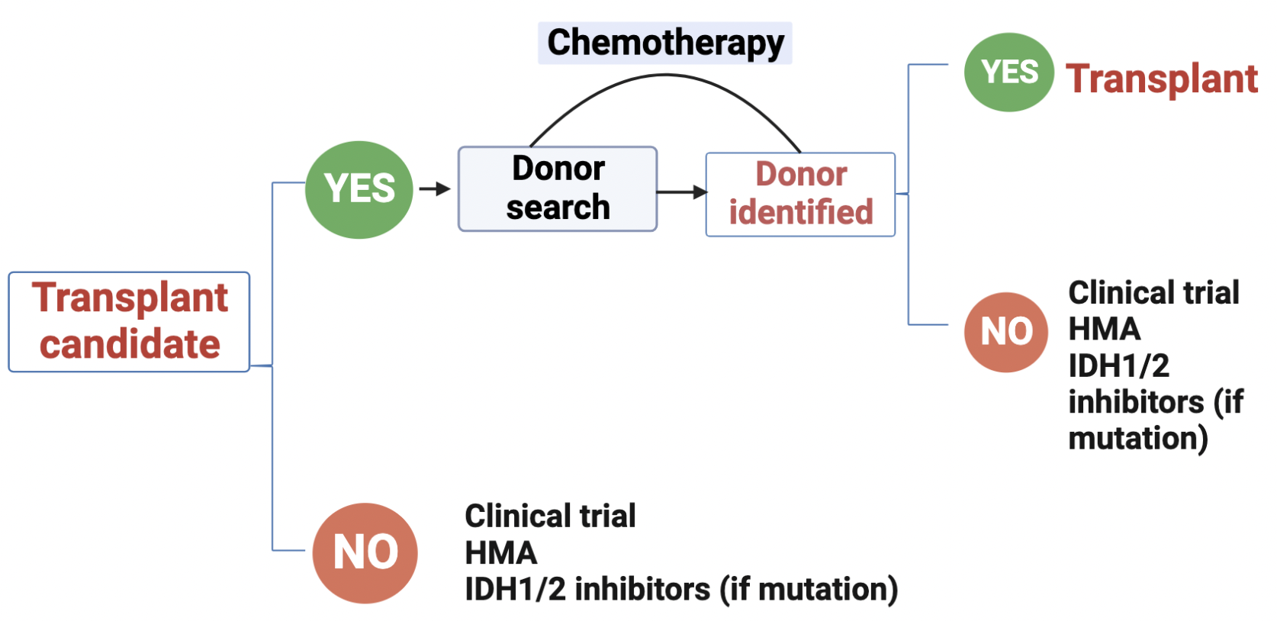

Slide 29
Conclusion
Higher-risk MDS needs early treatment
Treatment depends on patient preferences, medical fitness, and disease characteristics
Bone marrow transplant has the best chance of cure, prolonging life
Initiate donor search as soon as possible if transplant is considered
Low intensity treatment with azacitidine, decitabine, decitabine-cedazuridine are commonly used
Supportive care with blood and platelet transfusions, treatment of infections for all patients

Slide 30
Thank you!
Prajwal Dhakal, MBBS
Clinical Assistant Professor
Division of Hematology, Oncology, Blood & Marrow Transplantation
University of Iowa

