Slide 1
Role of Hematopoietic Stem Cell Transplantation in MDS and SAA
April 15th, 2023
Krishna Gundabolu MD; MS; FACP
Associate Professor
Department of Hematology-Oncology

Slide 2
DISCLOSURES
Principal investigator role | Samus, Pfizer; Autolus
Employee | None
Consultant | None
Speakers' bureau | None
Scientific Advisory Board | Blueprint Medicines, Sanofi, BMS Therapeutics, Spark Therapeutics.
Others | NCCN panel member: MPN, systemic mastocytosis and Clonal Lymphoid/Myeoid Neoplasms. Discussion on molecules in clinical trial

Slide 3
Objectives
To understand the pathophysiology of MDS, AA and PNH.
To understand the overlapping areas in these bone marrow failure states
To discuss the principles of transplant in Bone Marrow Failure states including MDS and severe aplastic anemia.

Slide 4
Case
62 y old man with no significant past medical history presented with progressive fatigue to his primary care physician. A complete blood count revealed WBC count of 2100/µL with ANC of 1200/µL; Hemoglobin of 9.2 gm/dL, platelet count of 92,000/µL. Bone marrow biopsy showed 2% blasts by immunohistochemistry staining. There is evidence of trilineage dyspoesis by morphology. Cytogenetics revealed normal karyotype of 46,XY[20]. MDS FISH panel was unremarkable. A myeloid mutation analysis revealed pathogenic mutations in ASXL1, DNMT3A, RUNX1 and U2AF1.
What would you recommend?
Start her on Erythroid Stimulating Agents
Observe and follow up in 6 months
Start Lenolidamide
HLA type her and refer to stem cell transplant evaluation

Slide 5
MDS
A group of clonal hematopoietic stem cell diseases characterized by cytopenia(s), dysplasia in one or more of major myeloid cell lines, ineffective hemopoiesis and increases risk of development of AML. –WHO: Classification of hematopoietic and Lymphoid Tissues: 2008: 4th Edition.
A group of clonal bone marrow neoplasms characterized by ineffective hematopoiesis, manifested by morphologic dysplasia in hematopoietic cells and by peripheral cytopenia(s).- WHO: 2016 revision.
Incidence: 4.5 cases per 100,000 people/year and goes higher with age with among 70-79 years and $≥$80 years age 26.9 and 55.4 per 100,000 people/year respectively; Around 15,000 cases per year. Men>Women; Whites> non-white.
Risk factors: Age, DNA damage, environmental, PNH/AA or hereditary causes.
D A Arber etal. WHO 2016 revision

Slide 6
Timeline in MDS
1982
1997
2001
2004-2005
2008
2012
2016
2020
2022
FAB
Low grade
RA; RARS
High grade
RAEB
RAEB-t
CMML
IPSS
Low risk
Int-1 risk
Int-2 risk
High risk
5-Aazcitidine
Decitabine
Lenalidomide
Deferasirox
R-IPSS
Very low
Low
Intermediate
High
Very high risk
Luspatercept
Decitabine-Cedazuridine
IPSS-M
WHO revision
Isolated del5q
RCUD
WHO Revision
CMML
MDS/MPN
RAEB-t-> AML
RA->RCMD
RAEB 1,2
WHO revision
RA->MDS
MDS-SLD
MDS-RS
MDS-MD
MDS with excess blasts
MDS-MN
MDS-with germline predisposition

Slide 7
IPSS and IPSS-R
Score values
Prognostic variable | 0 | 0.5 | 1.0 | 1.5 | 2.0
Marrow blast % | <5 | 5-10% | - | 11-20 | 21-30
Karyotype | Good | Intermediate | Poor | - | -
Cytopenia | 0/1 | 2/3
Score values
Prognostic variable | 0 | 0.5 | 1 | 1.5 | 2 | 3 | 4
CyG | Very good | - | Good | - | Intermediate | Poor | Very poor
Marrow blasts% | $≤$2 | - | >2-<5 | - | 5-10 | >10 | -
Hemoglobin | $≥$10 | - | 8-<10 | <8 | - | - | -
Platelets | $≥$100 | 50-<100 | <50 | - | - | - | -
ANC | $≥$0.8 | <0.8 | - | - | - | - | -
IPSS risk category | Overall Score | Medial survival in the absence of therapy | 25% AML progression in the absence of therapy
Low | 0 | 5.7 | 9.4
Int-1 | 0-5-1.0 | 3.5 | 3.3
Int-2 | 1.5-2.0 | 1.1 | 1.1
High | $≥$2.5 | 0.4 | 0.2
IPSS_R; Risk category | Overall score | Median survival in the absence of therapy | 25% progression risk to AML
Very low | $≤$1.5 | 8.8 | NR
Low | >1.5-$≤$3.0 | 5.3 | 10.8
INT | >3-$≤$4.5 | 3 | 3.2
High | >4-$≤$6.0 | 1.6 | 1.4
Very high | >6.0 | 0.8 | 0.7
Cytogenetics: Good=normal, -Y alone, del(5q) alone, del (20q) alone, poor=complex$≥$3 abnormalities) or chromosome 7 anomalies; Intermediate=other abnormalities [excludes t(8;21); inv(16); t(15;17)]
Cytopenia: ANC<800/mcL, Platelets <100,000/mcL, Hb <10 g/dL.
Cytogenetics: Very good=-Y, del(11q); Good: normal, del(5q), del(12p), del(20q), double including del(5q); Intermediate=del(7q), +8, +19, i(17q), any other single of double clones; Poor=-7, inv(3)/t(3q)/del(3q), double including -7/del(7q), complex: $≤$3 abnormalities; Very complex=>3 abnormalities.
Greenberg P etal, Blood 1997; 89:2079-2088
Greenberg P etal, Blood 2012; 120:2454-2465

Slide 8
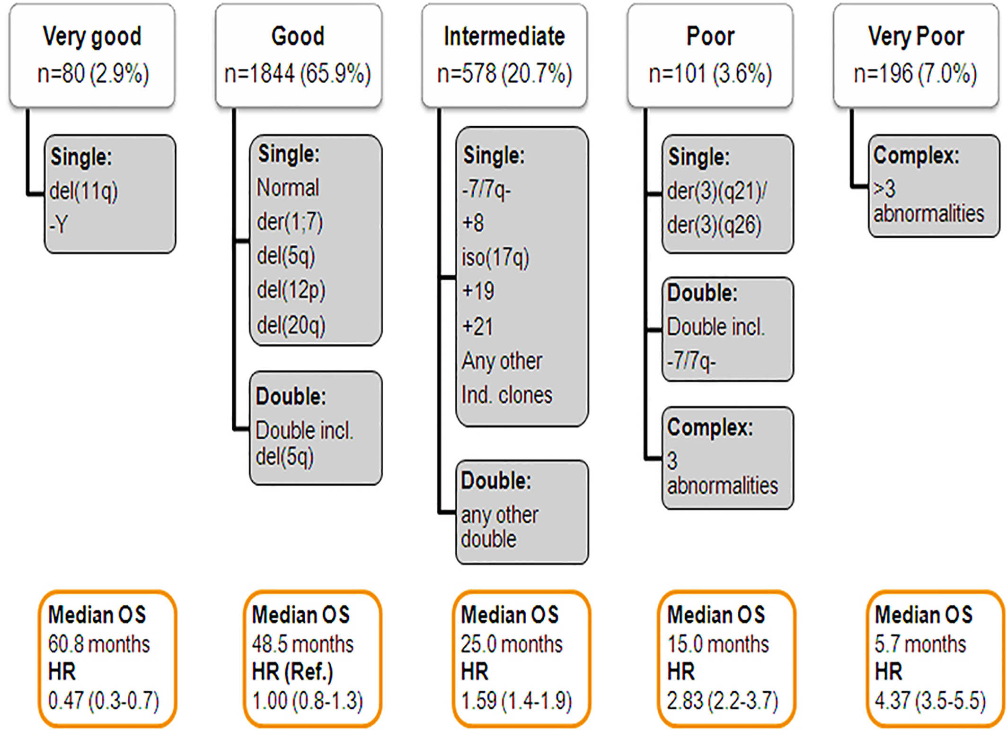
IPSS-R
Schanz J et al. JCO 2012;30(8):820-829.
Notes:
Cytogenetic classification of MDS. Adapted from Schanz J, et al23

Slide 9
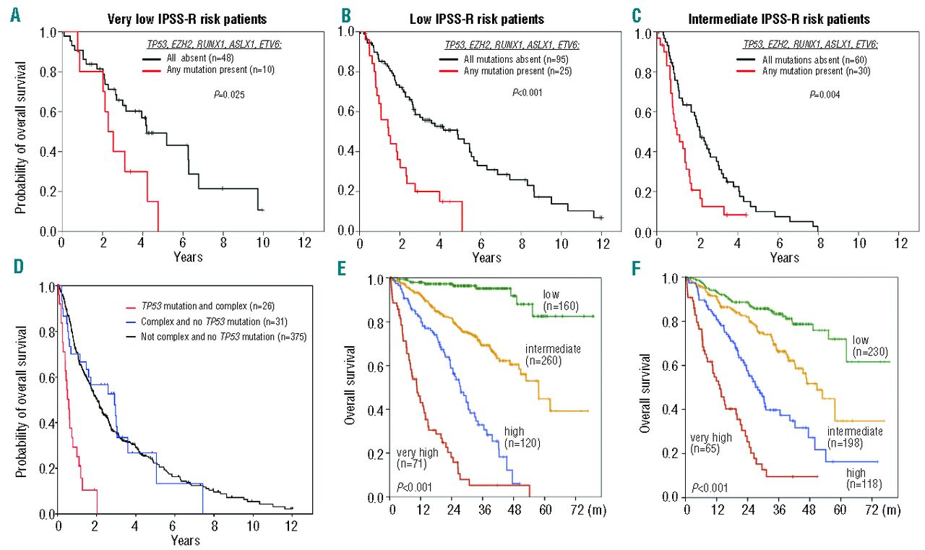
Impact of mutations
Bejar R Haematologica Vol. 99 No. 6 (2014): June, 2014
Notes:
Combining somatic mutations with known risk factors and prognostic models. (A–C) Data from Bejar et al.38 is used to compare overall survival in patients with one or more prognostically adverse mutations (in TP53, EZH2, RUNX1, ASXL1, or ETV6) to unmutated patients within each of the IPSS-R ‘lower’ risk groups. Mutations identify added disease risk in each of the categories. (D) Overall survival of patients with complex disease karyotypes is strongly stratified by TP53 mutation status. Patients with both a complex karyotype and TP53 mutation have a very short overall survival whereas complex karyotype patients without a TP53 mutation have a survival that is comparable to that of MDS patients with non-complex karyotypes. (E) Overall survival in 611 MDS patients examined by Haferlach et al.40 and stratified according to a mutation-only prognostic model considering the weighted contribution of mutations in 14 genes. (F) Overall survival in the same 611 patients risk stratified by a prognostic model that combines both clinical features and the mutation status of 14 genes. Reprinted with permission.

Slide 10
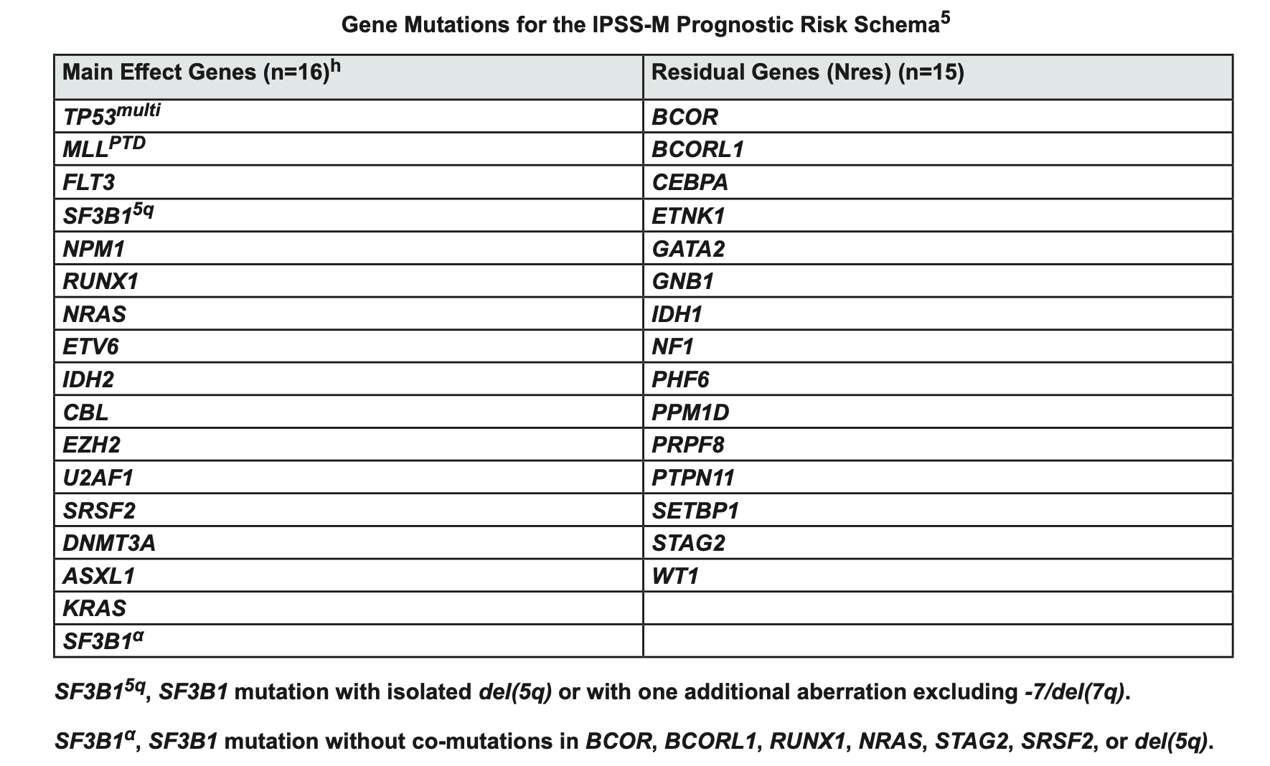
NCCN 2023.1

Slide 11
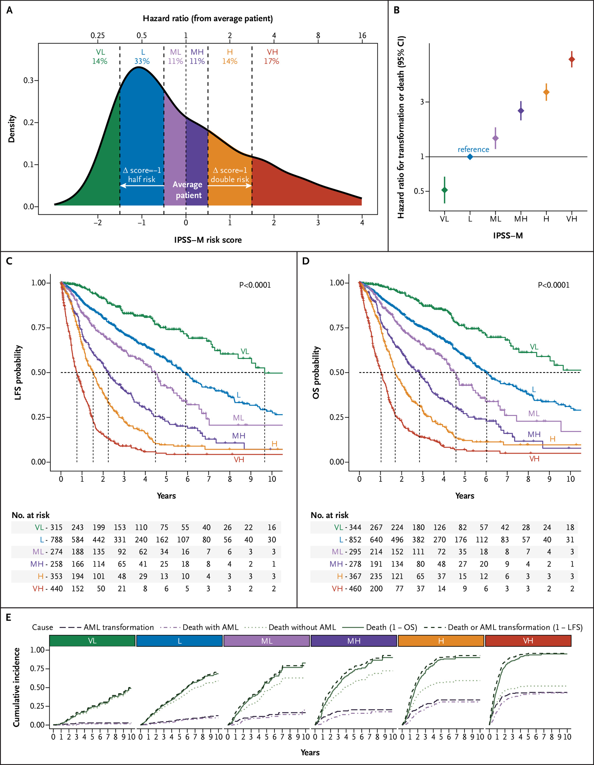
IPSS-M
E Bernard etal. NEJM Evid 2022;1(7)

Slide 12
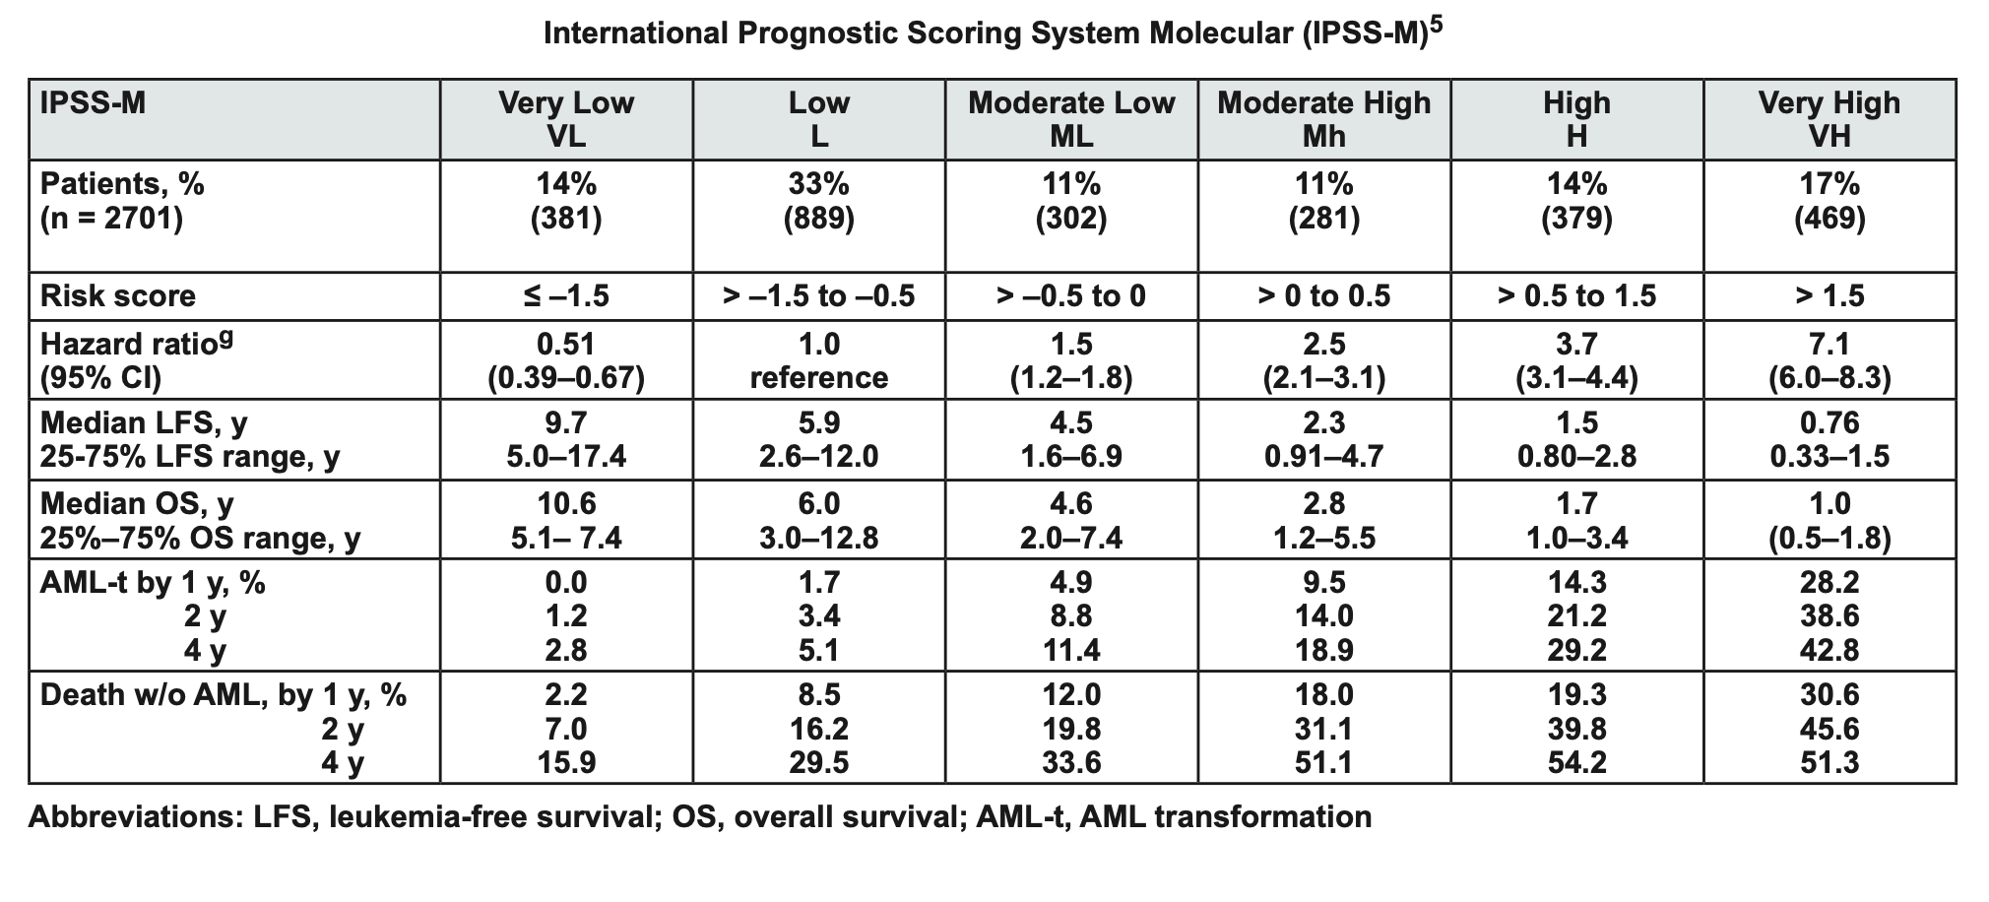
IPSS-M
E Bernard etal. NEJM Evid 2022;1(7)

Slide 13
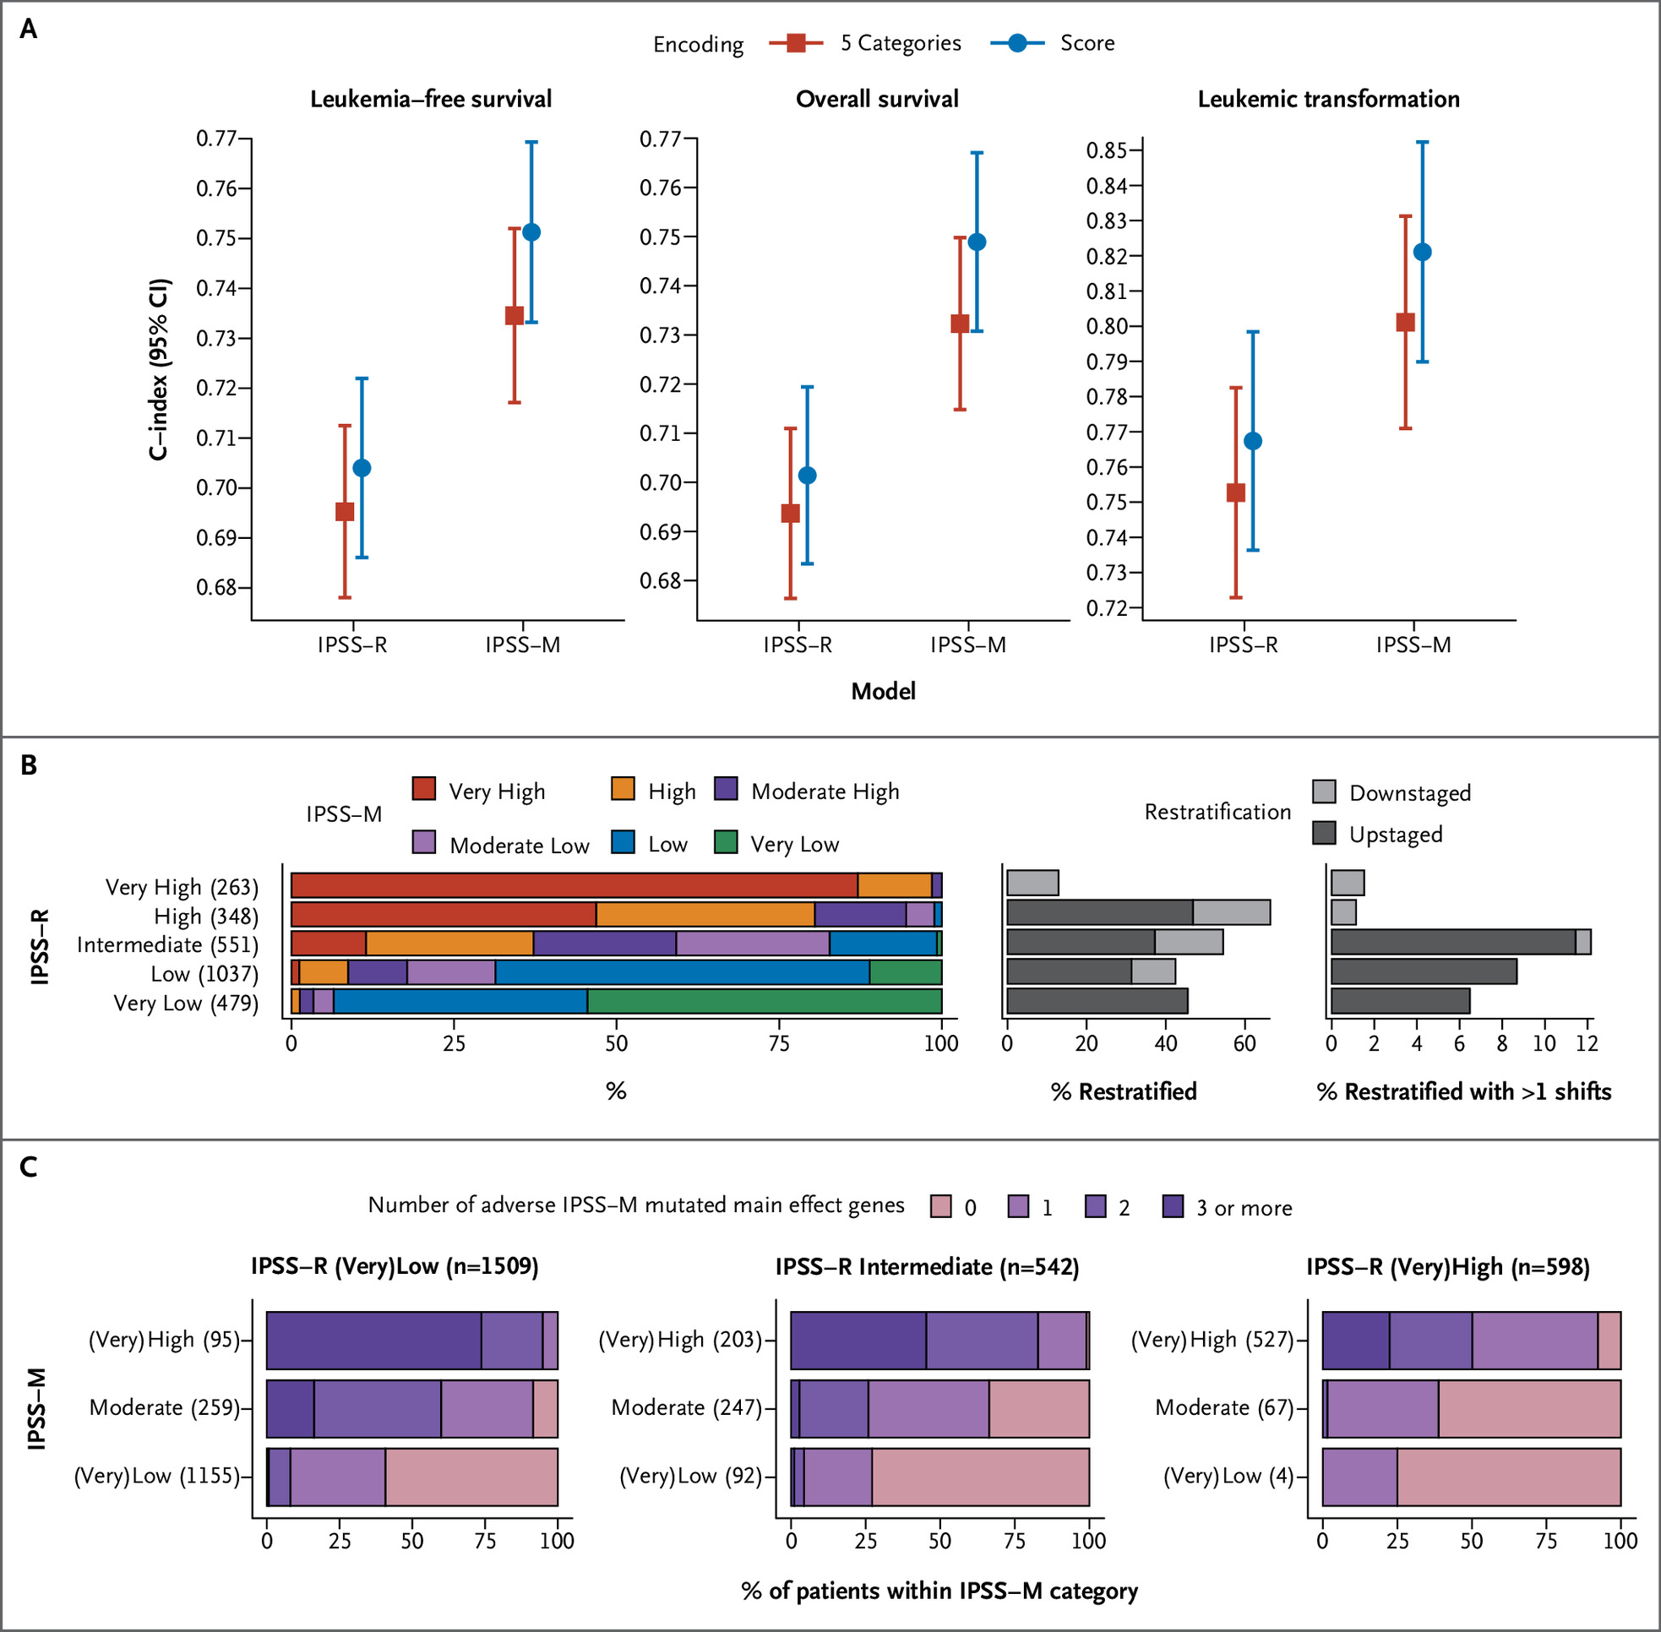
Comparison of the International Prognostic Scoring System–Revised and the International Prognostic Scoring system- Molecular
E Bernard etal. NEJM Evid 2022;1(7)

Slide 14
Number of HCTs in the US Reported to CIBMTR by Transplant Type
Notes:
Slide 2: The annual numbers of transplant in the U.S. were compiled according to the number of first transplants of recipients registered with the CIBMTR. The number of allogeneic transplants surpasses 8,000 a year in the US in 2015 with 8,326 transplants in 2020, from 8,740 in 2019.
The number of autologous transplants in the US had steadily increased since 2000 with 11,557 transplants in 2020.

Slide 15
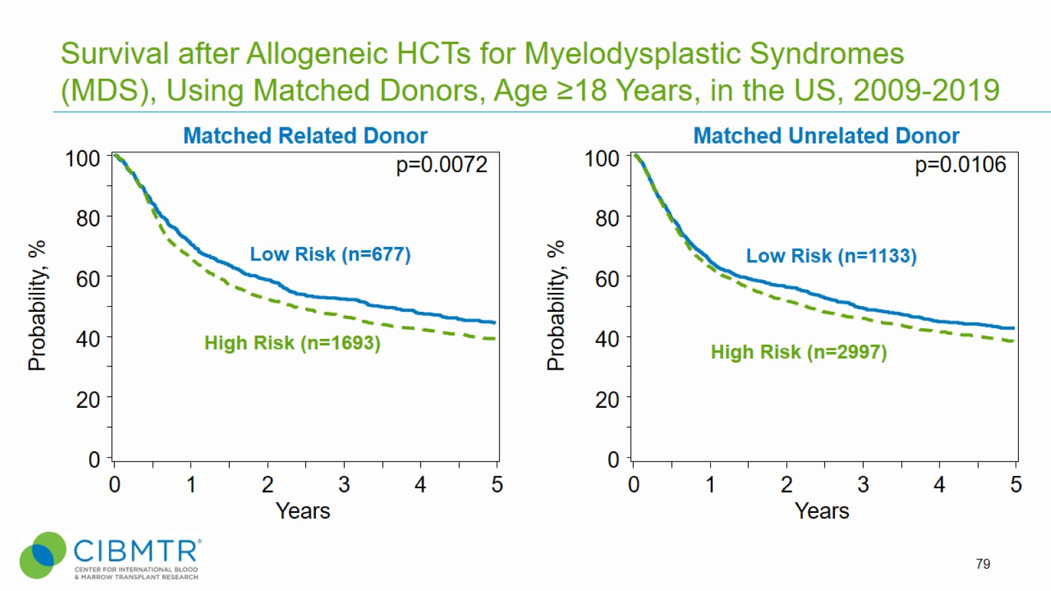
Survival after Allogeneic HCTs for Myelodysplastic Syndromes (MDS), Using Matched Donors, Age ≥18 Years, in the US, 2009-2019
Notes:
Slide 79: Allogeneic transplant is a potentially curative treatment for Myelodysplastic syndromes (MDS). Outcomes differ according to disease status at the time of transplant. For allotransplant for low and high risk MDS performed between 2009 and 2019. The 3-year probabilities (95%CI) of survival were 52% (48-56%) and 49% (46-52%) for recipients of matched related donor and matched unrelated donor transplants for low risk MDS, respectively.
Among patients with high risk MDS, corresponding probabilities (95%CI) were 46% (44-49%) and 46% (44-48%).
Reference for MDS classifications:
https://higherlogicdownload.s3.amazonaws.com/ASBMT/43a1f41f-55cb-4c97-9e78-c03e867db505/UploadedImages/ASBMT_RFI_2018B_CIBMTR_Disease_Classifications.pdf
Trend data only is presented and any significant p values reflect global differences between indicated groups and not any specific differences between indicated groups. Caution interpreting these univariate curves is important as adjustment for other relevant factors using multi-variable analyses has not been done.

Slide 16
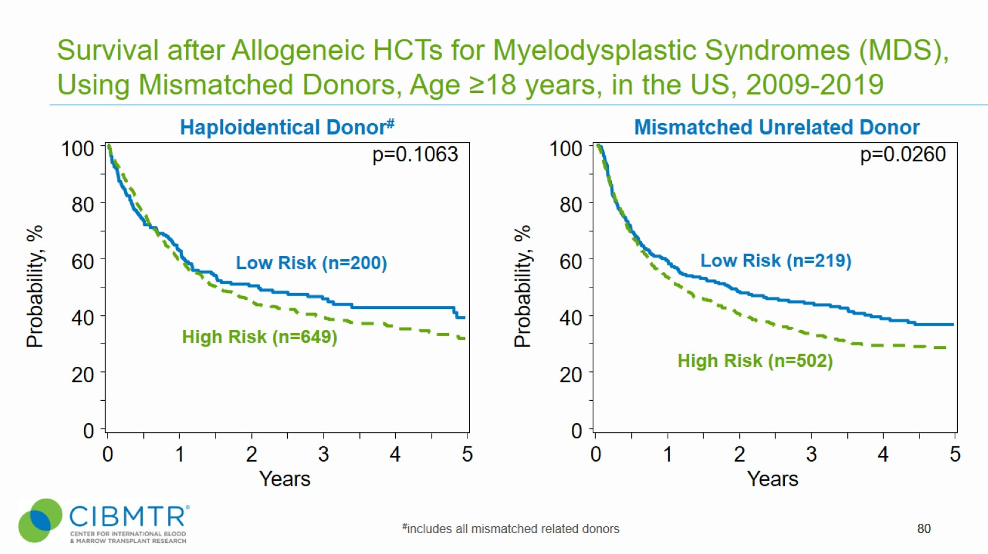
Survival after Allogeneic HCTs for Myelodysplastic Syndromes (MDS), Using Mismatched Donors, Age ≥18 years, in the US, 2009-2019
Notes:
Slide 80: Allogeneic transplant is a potentially curative treatment for myelodysplastic syndromes (MDS). Outcomes differ according to disease status at the time of transplant. For allotransplant for low and high risk MDS performed between 2009 and 2019. The 3-year probabilities (95%CI) of survival were 47% (40-55%) and 44% (38-51%) for recipients of Haploidentical donor and mismatched unrelated donor transplants for low risk MDS, respectively.
Among patients with high risk MDS, corresponding probabilities (95%CI) were 39% (35-43%) and 33% (29-38%).
Trend data only is presented and any significant p values reflect global differences between indicated groups and not any specific differences between indicated groups. Caution interpreting these univariate curves is important as adjustment for other relevant factors using multi-variable analyses has not been done.

Slide 17
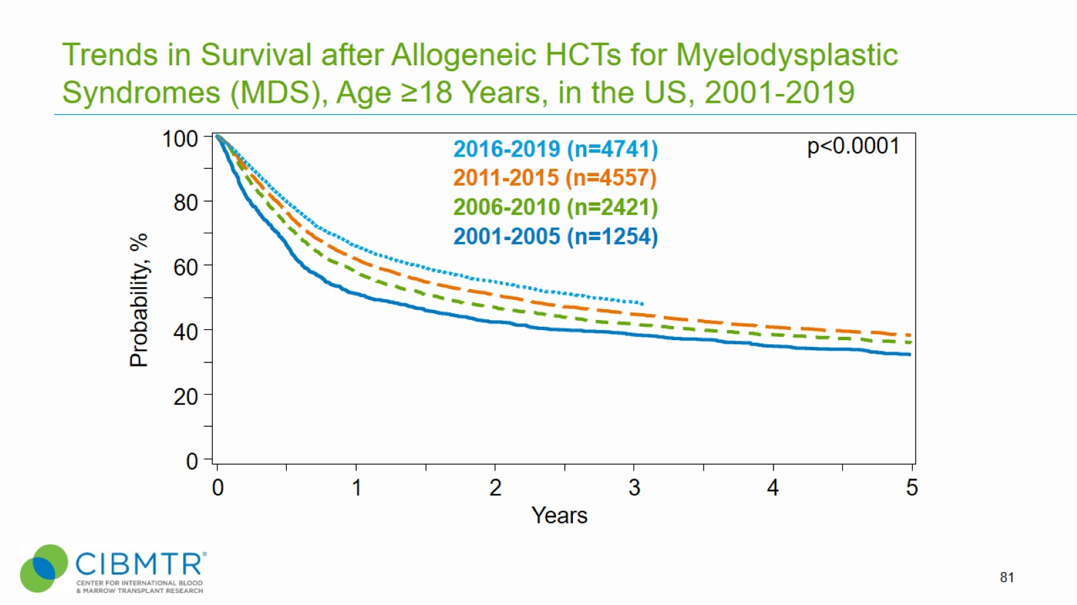
Trends in Survival after Allogeneic HCTs for Myelodysplastic Syndromes (MDS), Age ≥18 Years, in the US, 2001-2019
Notes:
Slide 81: Survival after allogeneic HCT for MDS shows slight improvements over time in the early 0-3 years post-transplant phase. The 3-year survival probabilities (95%CI) were 38% (36-41%) for 2001-2005, 42% (40-44%) for 2006-2010, 45% (43-46%) for 2011-2015, and 49% (47-50%) for 2016-2019.
Trend data only is presented and any significant p values reflect global differences between indicated groups and not any specific differences between indicated groups. Caution interpreting these univariate curves is important as adjustment for other relevant factors using multi-variable analyses has not been done.

Slide 18
Causes of Death after Matched Related Donor HCTs in the US, 2018-2019
Notes:
Slide 51: Causes of death for recipients receiving MRD HCT are shown

Slide 19
Causes of Death after Matched Unrelated Donor HCTs in the US, 2018-2019
Notes:
Slide 52: Causes of death for recipients receiving MUD HCT are shown

Slide 20
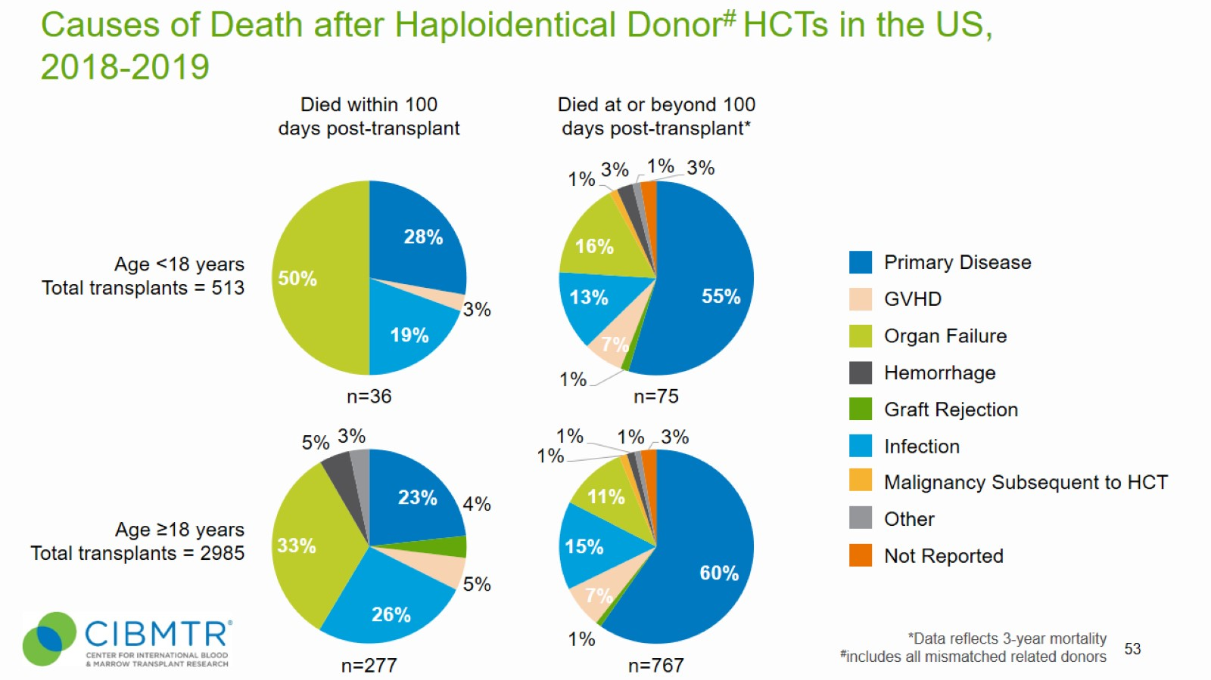
Causes of Death after Haploidentical Donor# HCTs in the US, 2018-2019
Notes:
Slide 53: Causes of death for recipients receiving Haplo HCT are shown

Slide 21
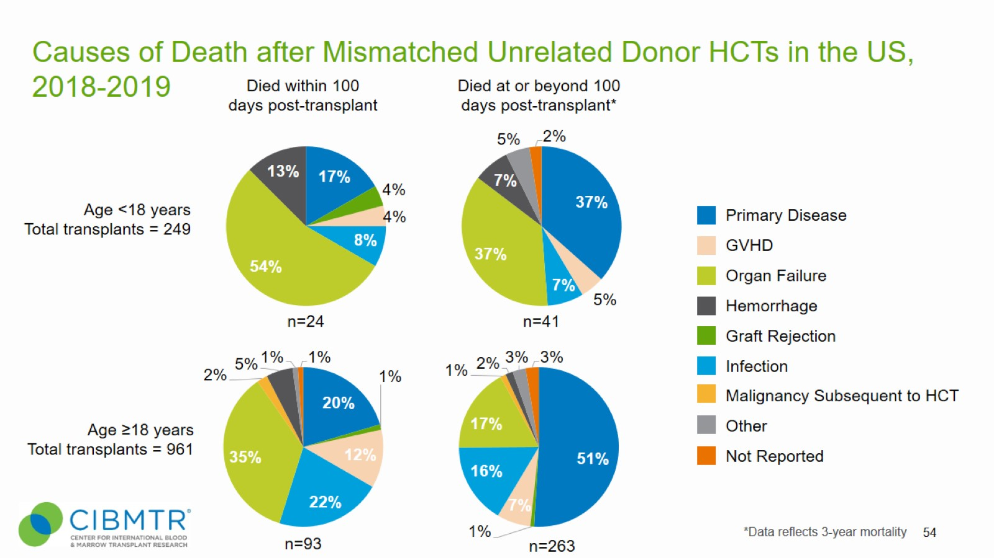
Causes of Death after Mismatched Unrelated Donor HCTs in the US, 2018-2019
Notes:
Slide 54: Causes of death for recipients receiving MMUD HCT are shown

Slide 22
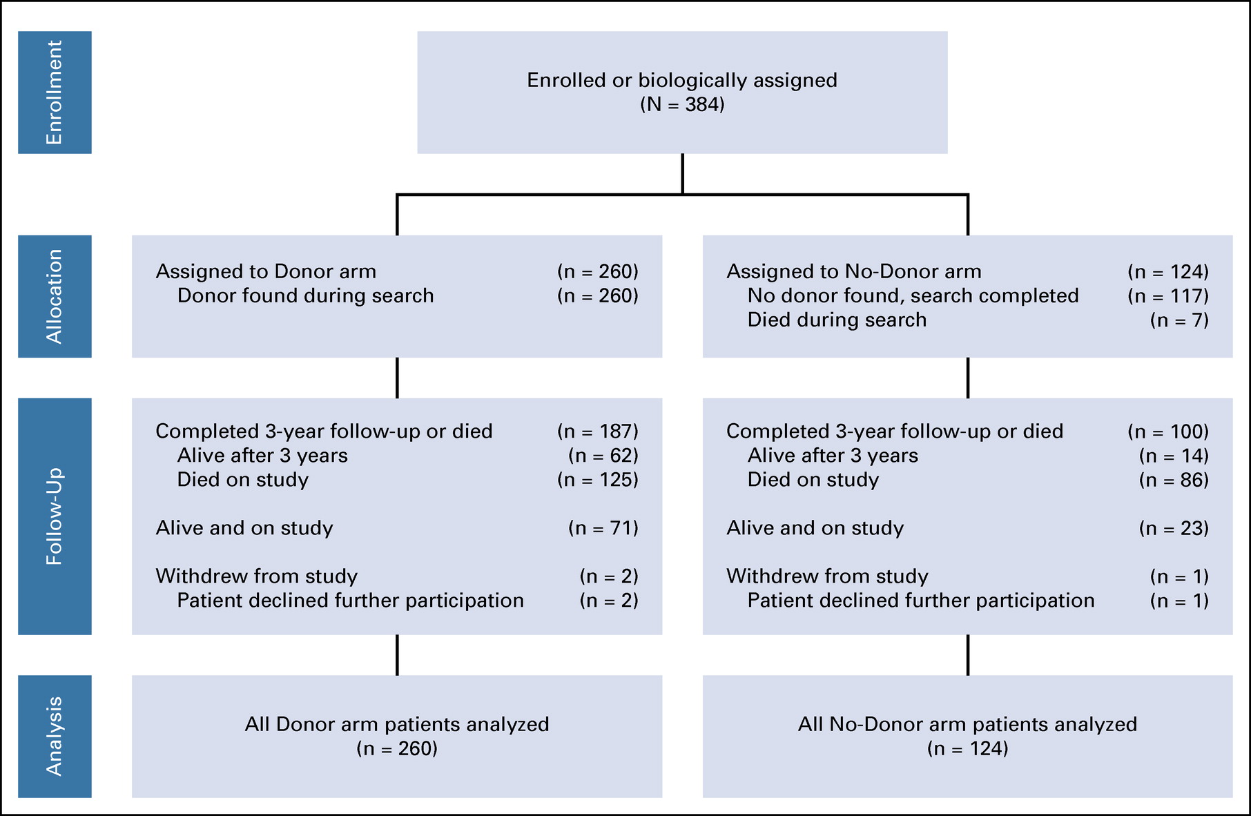
Biologic Assignment Trial of Reduced-Intensity Hematopoietic Cell Transplantation Based on Donor Availability in Patients 50-75 Years of Age With Advanced Myelodysplastic Syndrome (BMT CTN 1102)
50-75 years of age with intermediate-2 or high-risk de novo MDS
Ryotaro Nakamura etal. Journal of Clinical Oncology 2021 393328-3339.
Notes:
FIG 1. CONSORT diagram for BMT CTN 1102. Two hundred sixty (67.7%) of the enrolled subjects were biologically assigned to the Donor arm and 124 (32.3%) assigned to the No-Donor arm. On the Donor arm, 187 (71.9%) of the participants have completed the 3-year follow-up period, with 62 surviving until 3 years and 125 dying. Of the No-Donor arm participants, 100 (80.6%) have completed the follow-up period, 14 surviving until the 3 years and 86 dying. Three subjects withdrew from study, two on the Donor arm and one on the Non-Donor arm, each declining to participate further in completing study visits and quality-of-life assessments. The remaining 71 subjects on the Donor arm and 23 on the Non-Donor arm are still being followed until the 3-year mark.

Slide 23
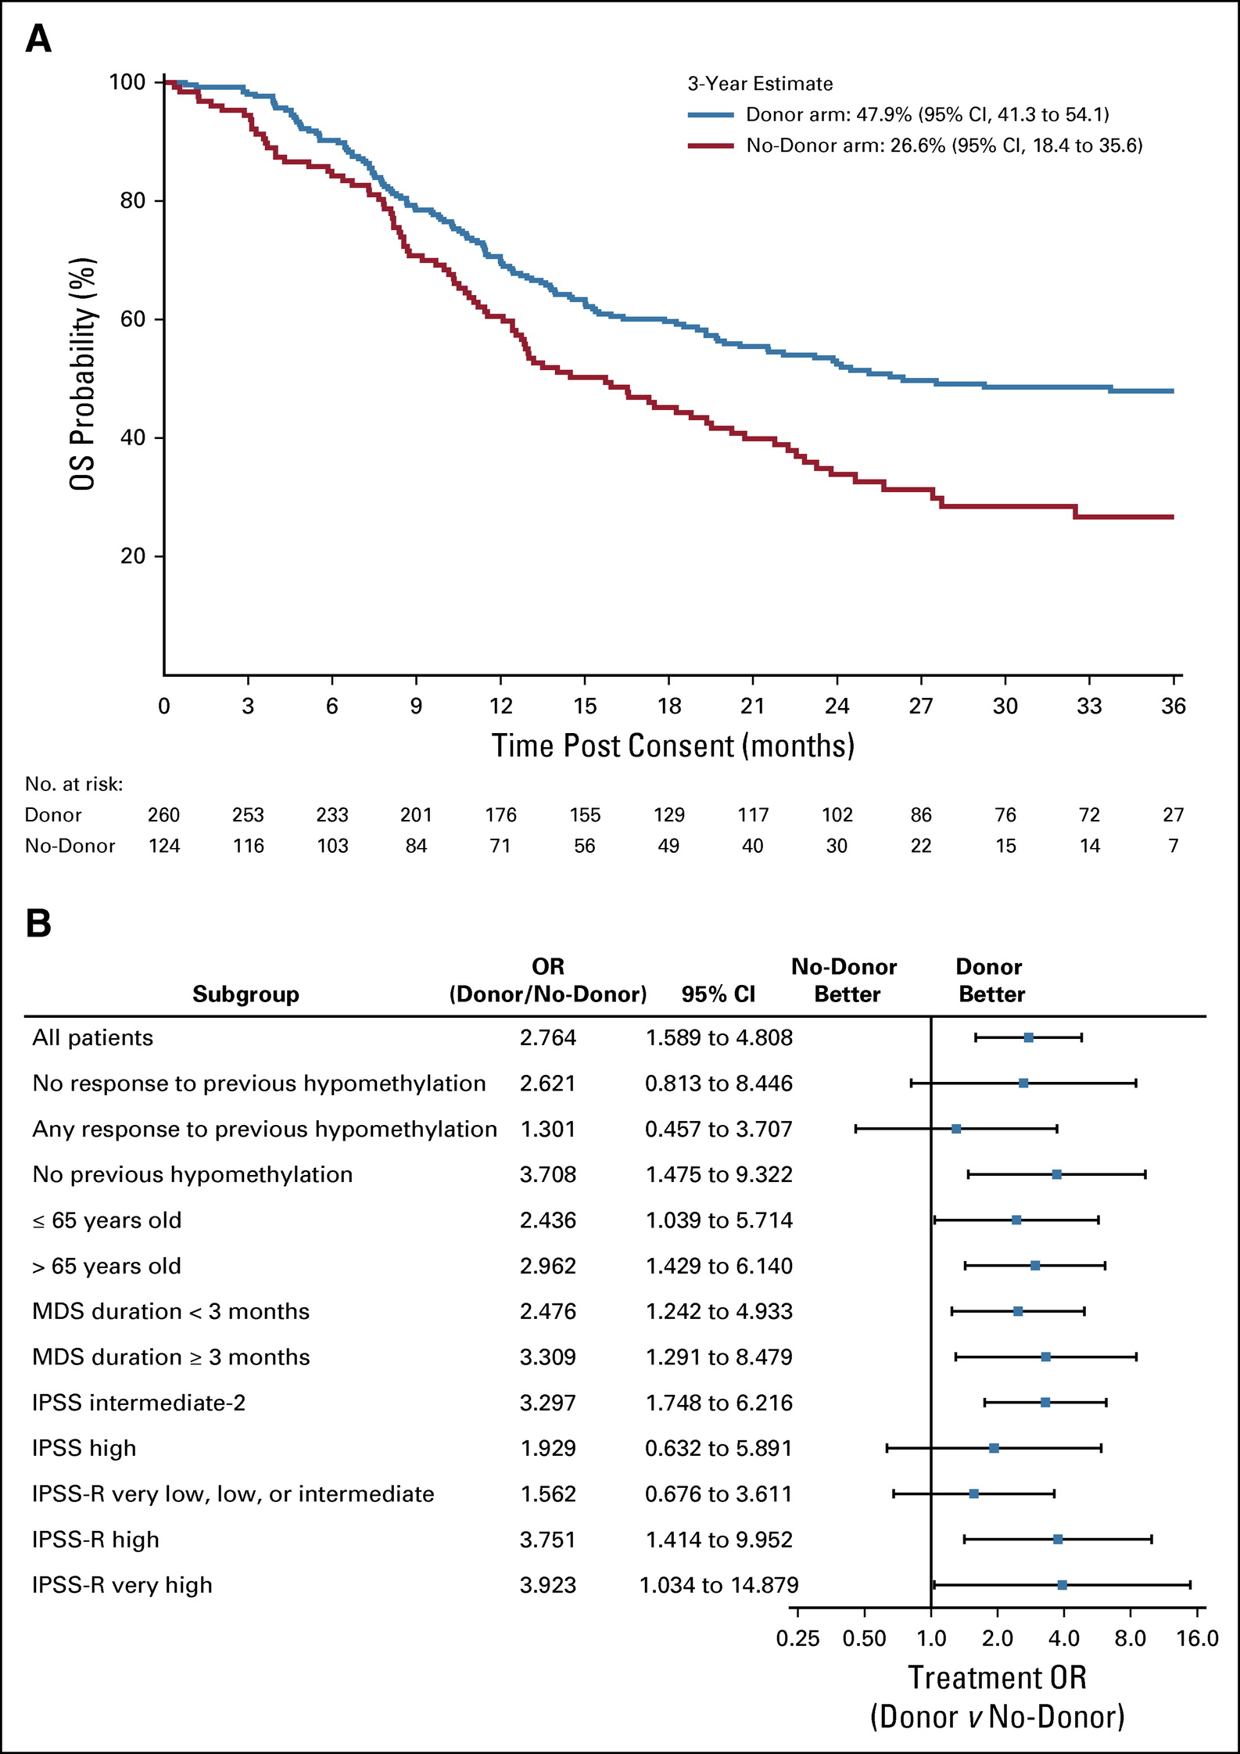
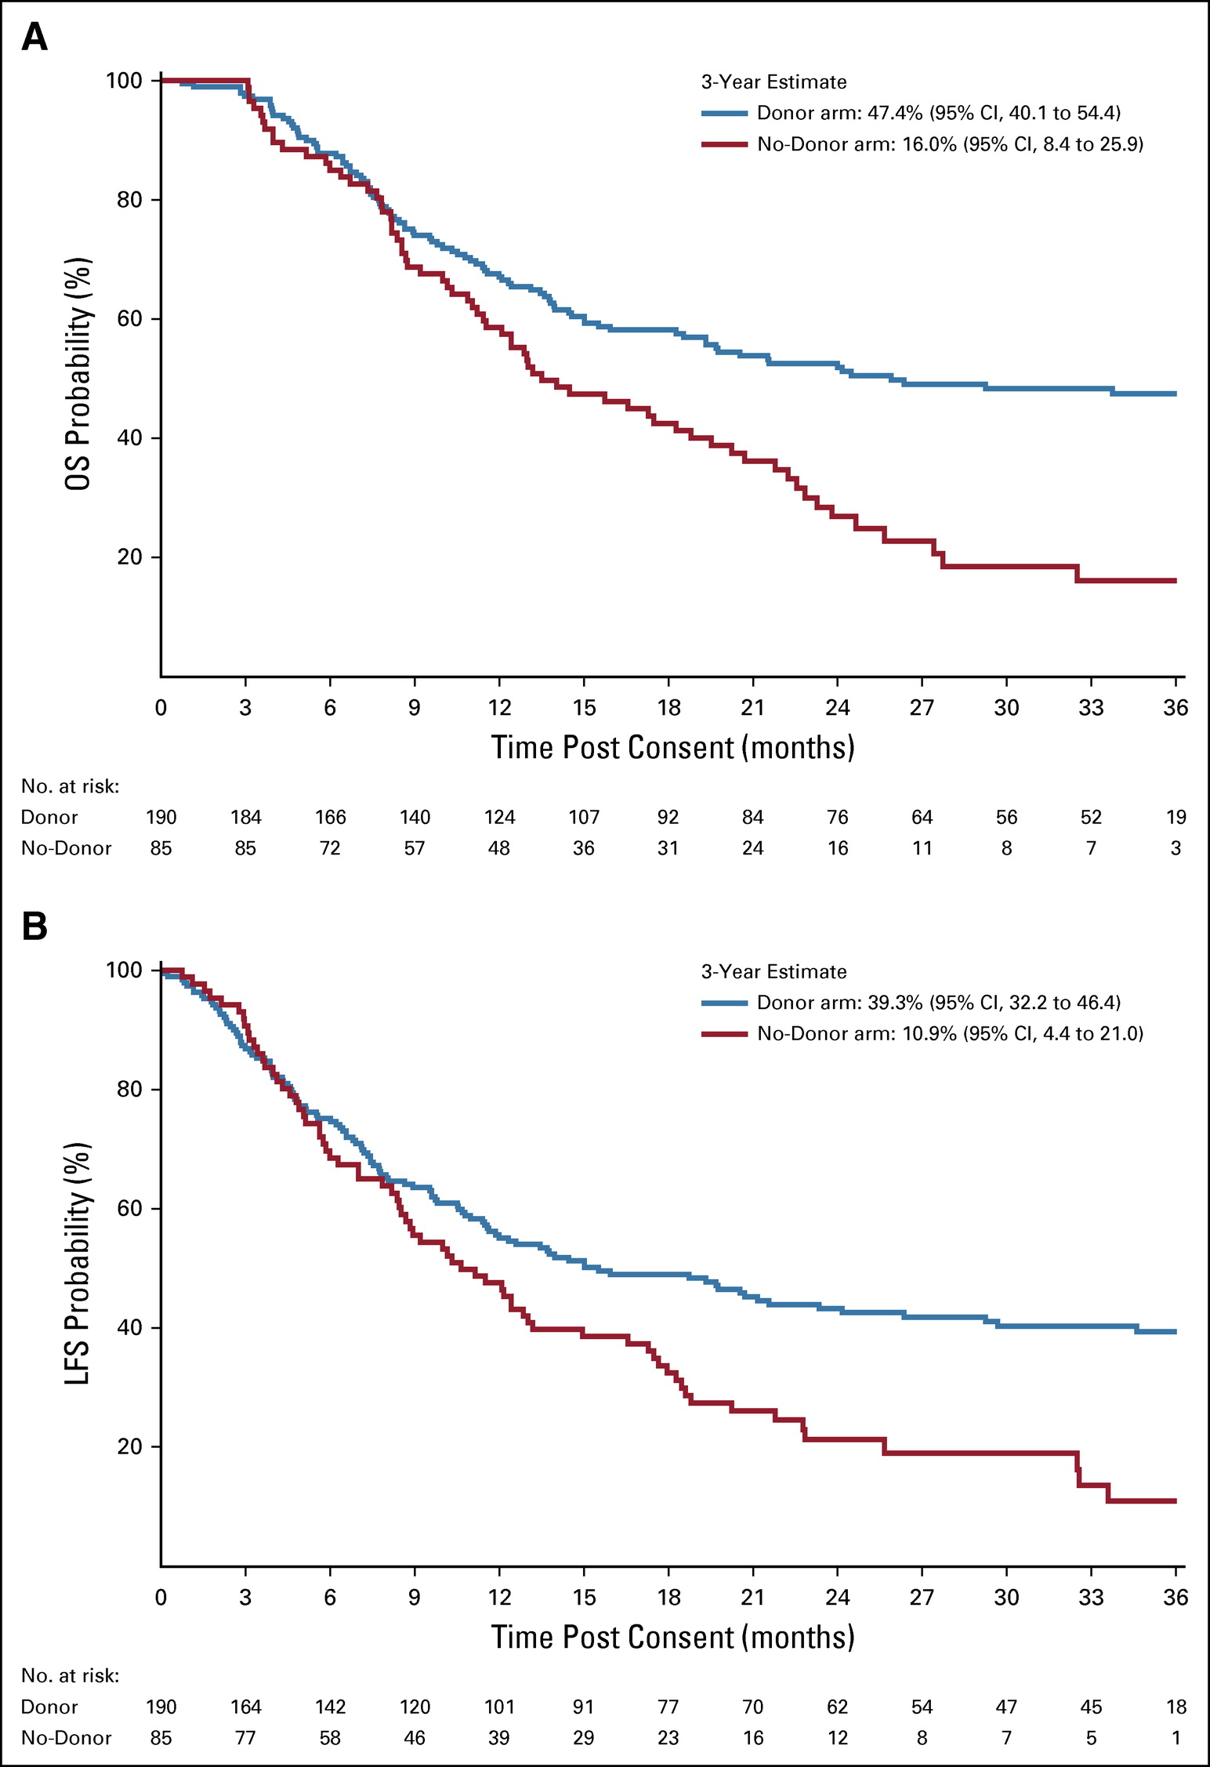
FIG 2. (A) Estimates of OS after registration. OS curves are adjusted for age, race or ethnicity, performance status, IPSS score, duration of disease, and response to HMA in an intention-to-treat analysis. (B) Forest plot of subgroup analyses for OS. The forest plot shows the OR of OS at 3 years for Donor versus No-Donor arm subjects in subgroups determined by age, race or ethnicity, performance status, IPSS score, duration of disease, and response to HMA. NOTE. x-axis has a logarithmic scale. (C) Estimates of LFS after registration. LFS curves are adjusted for age, race or ethnicity, performance status, IPSS score, duration of disease, and response to HMA in an intention-to-treat analysis. (D) Forest plot of subgroup analyses for LFS. The forest plot shows the OR for LFS at 3 years after consent for Donor versus No-Donor arm subjects in subgroups determined by age, race or ethnicity, performance status, IPSS score, duration of disease, and response to HMA. NOTE. x-axis has a logarithmic scale. HMA, hypomethylating agent; IPSS, International Prognostic Scoring System; IPSS-R, Revised International Prognostic Scoring System; LFS, leukemia-free survival; MDS, myelodysplastic syndromes; OR, odds ratio; OS, overall survival.
FIG 3. (A) Estimates of OS after registration, as-treated analysis. OS curves are adjusted for age, race or ethnicity, performance status, IPSS score, duration of disease, and response to HMA in an as-treated analysis. (B) Estimates of LFS after registration, as-treated analysis. LFS curves are adjusted for age, race or ethnicity, performance status, IPSS score, duration of disease, and response to HMA in an as-treated analysis. HMA, hypomethylating agent; IPSS, International Prognostic Scoring System; LFS, leukemia-free survival; OS, overall survival.

Slide 24
APLASTIC ANEMIA

Slide 25
Epidemiology
Young individuals (age 10–25 years) and the elderly (>60 years) are the most prone.
Incidence in the United States and Europe is below 2.5/million, while the incidence of AA in Asia is 2–3 times higher.
Environmental factors, such as drugs, toxins and chemicals may influence the incidence of AA

Slide 26
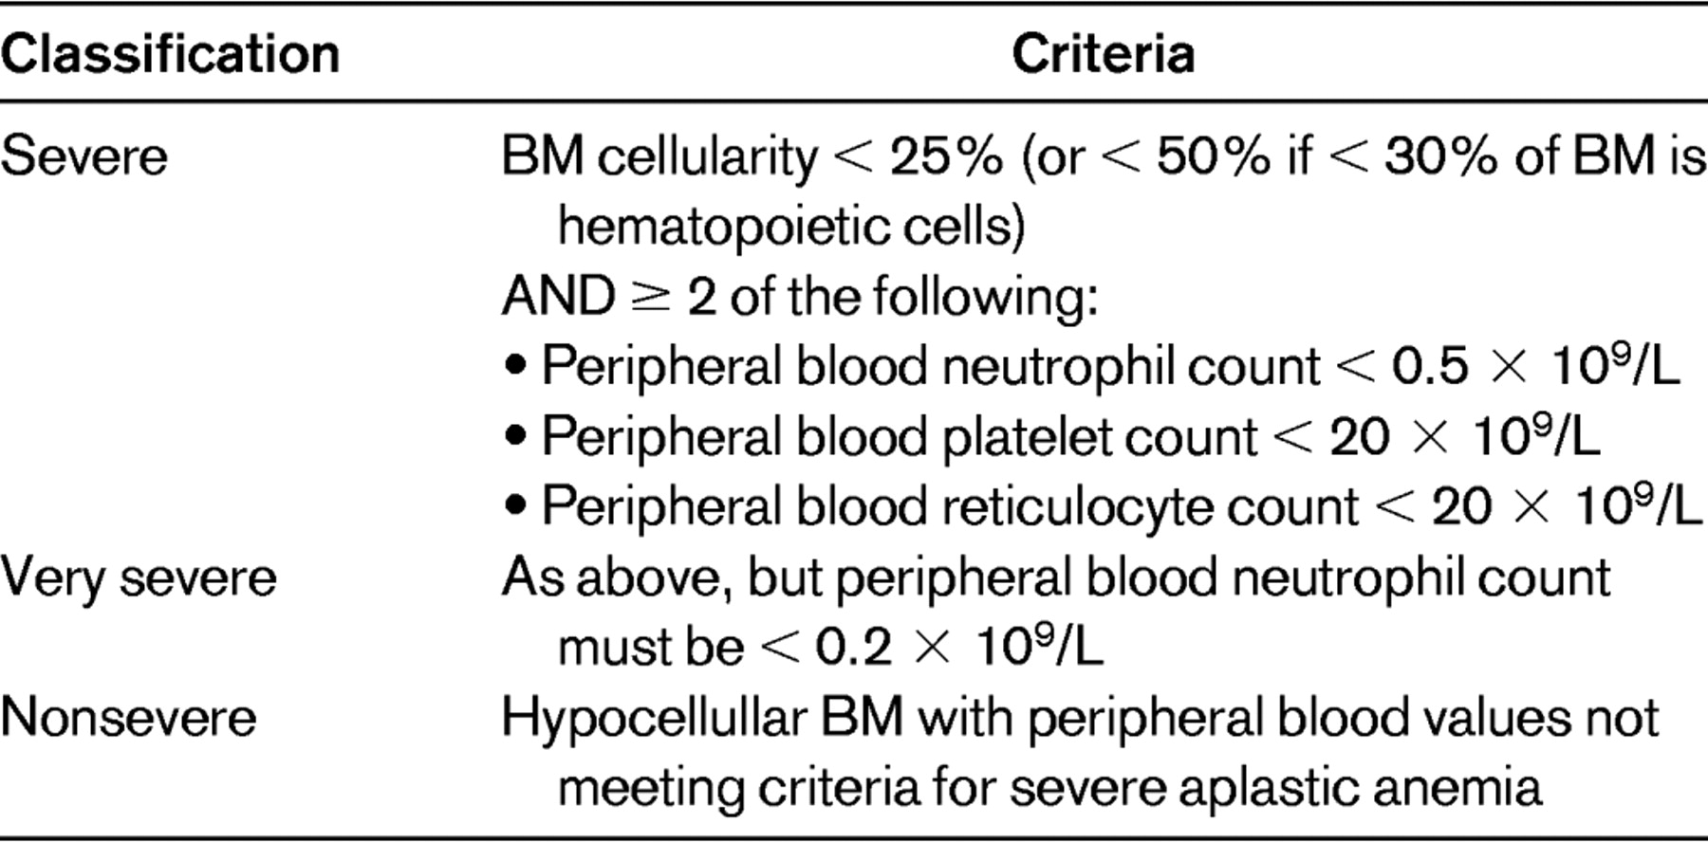
E Guinan . Hematology Am Soc Hematol Educ Program (2011) 2011 (1): 76–81.

Slide 27
Case
A 23-y old college student presented with heavy menstrual periods, gum bleeding and easy bruising. A complete blood count showed Hemoglobin of 5.8 gm/dL, absolute reticulocyte count of 10,000/µL, platelet count of 6,000/µL, WBC of 800/µL with ANC of 200/µL. A bone marrow biopsy showed a hypocellular bone marrow with <5% BM cellularity with hematopoietic cells. Cytogenetics showed normal karyotype 46, XX[20]. She has no exposure to any chemicals or radiation nor had started any new drugs. PNH screening showed a RBC clone 0.01%, Granulocyte clone 0.02% and monocytes 2%. She had remote history of Hashimoto's thyroiditis and currently takes Levothyroxine. What would you recommend her?
Obtain HLA typing and obtain HLA typing of her 2 siblings
Proceed to Cyclosporine-Equine ATG-Eltrombopag
Start her on Prednisone and reassure her that she has ITP
Start Eltrombopag single agent

Slide 28
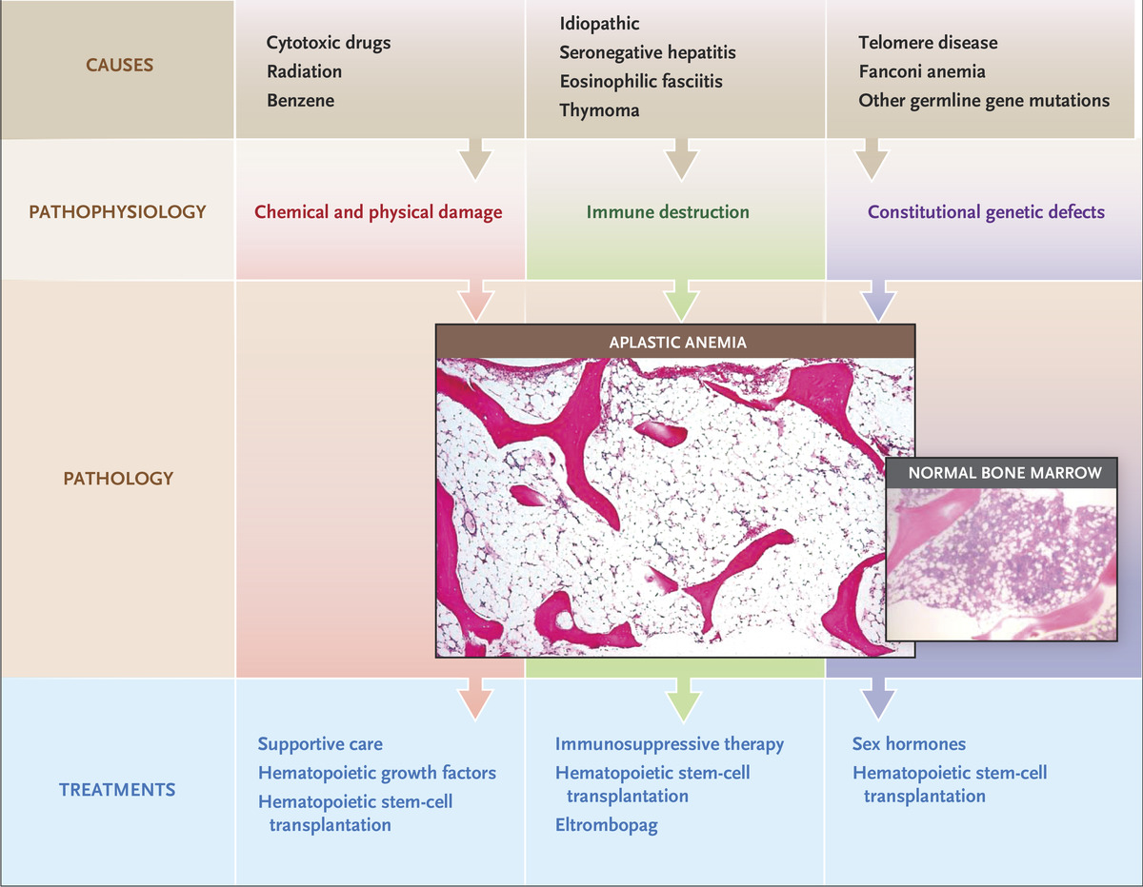
Diverse Pathophysiological Features that Lead to a Common Pathologic Process in Bone Marrow Failure.
NS Young. N Engl J Med 2018;379:1643-1656.
Notes:
Figure 1. Diverse Pathophysiological Features that Lead to a Common Pathologic Process in Bone Marrow Failure. Replacement of hematopoietic cells by fat is the distinctive pathologic feature of aplastic anemia. A hypocellular marrow can result from chemical or physical damage; the most frequent causes are iatrogenic, such as after cytotoxic chemotherapy or irradiation and exposure to benzene, usually in industry. In certain constitutional genetic defects that affect hematopoietic stem-cell function and the immune system, marrow failure and a hypocellular marrow are prominent. The disease immune aplastic anemia results from destruction, mainly by T cells, of hematopoietic stem cells and progenitor cells. Treatments are different for marrow damage, genetic defects that produce multiorgan effects, and the immune disease.

Slide 29
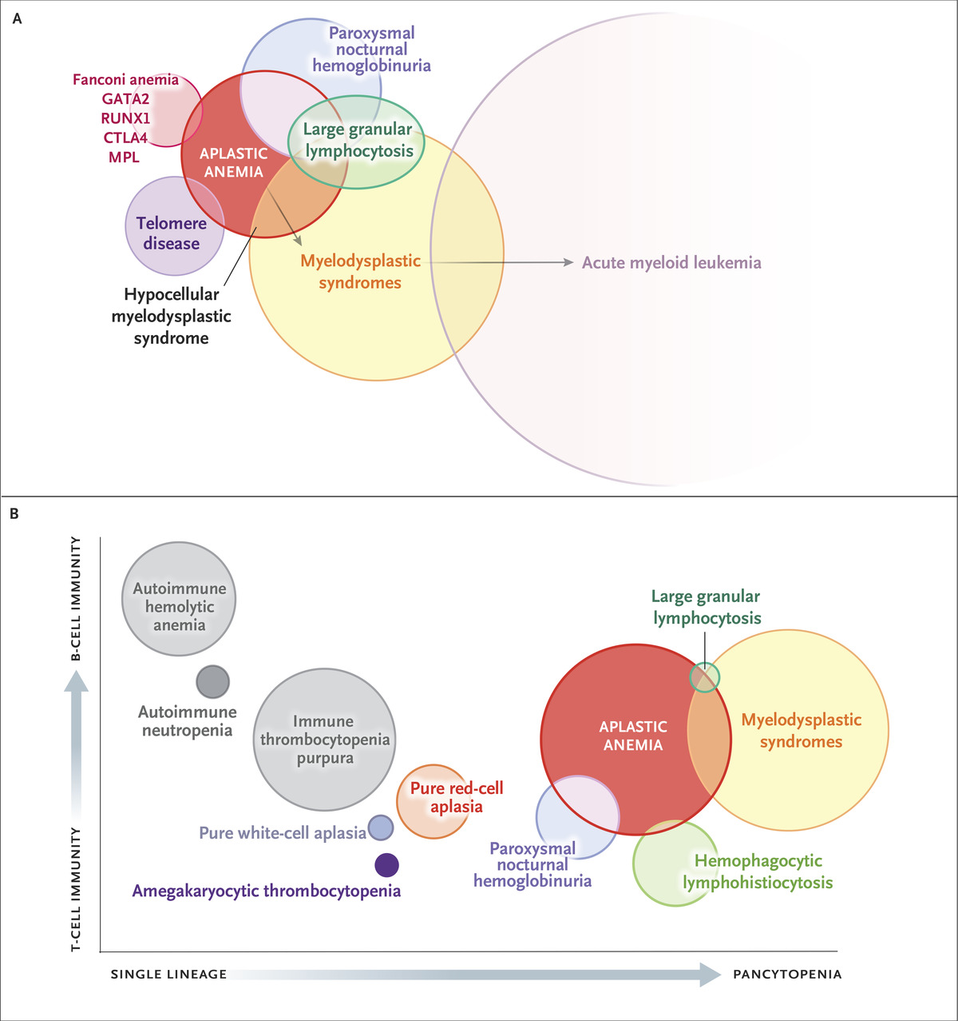
Aplastic Anemia in Relationship to Other Diseases.
NS Young. N Engl J Med 2018;379:1643-1656.
Notes:
Figure 2. Aplastic Anemia in Relationship to Other Diseases. The Venn diagram in Panel A highlights the overlap of aplastic anemia, both diagnostically and pathophysiologically, with paroxysmal nocturnal hemoglobinuria, myelodysplastic syndromes, and constitutional marrow failure syndromes. Many clinical and pathophysiological features of aplastic anemia parallel those of other immune-mediated diseases in which a single organ is targeted. Panel B shows the spectrum of immune cytopenias. The dominant immune effectors are delineated on the y axis; for example, autoimmune destruction of peripheral-blood cells is mainly antibody-mediated, whereas T cells have been implicated in marrow destruction. However, the immune response is almost certainly complex in all these diseases. (For schematic purposes, the circles in each Venn diagram have been scaled to the relative numbers of PubMed citations.)

Slide 30
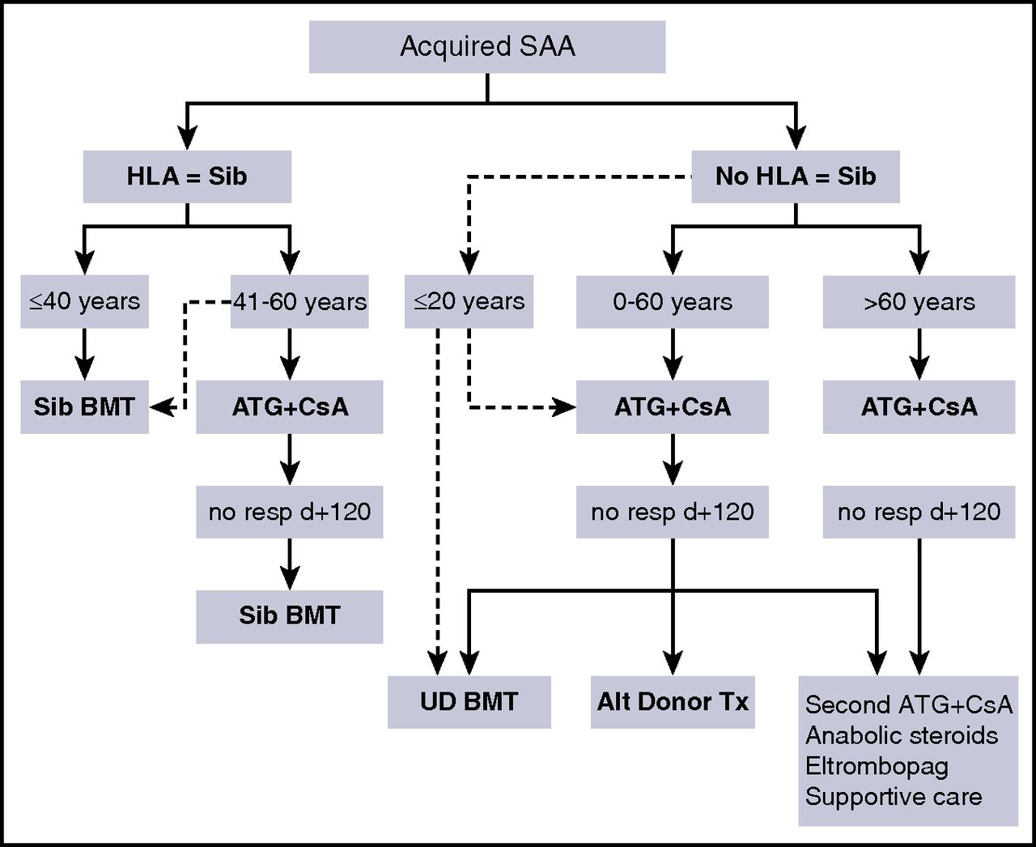
How I treat acquired aplastic anemia
Andrea Bacigalupo, How I treat acquired aplastic anemia, Blood, 2017, Figure 2.
Notes:
Figure Legend:
Treatment strategy in patients with acquired aplastic anemia. Patients are stratified according to whether or not they have an HLA-identical sibling. In young patients (<40 years) with a matched donor, allogeneic BMT is first-line therapy. In patients older than 40 years, and for patients without a matched sibling, ATG+CsA should be first-line therapy. In selected children with very severe disease, an unrelated donor (UD) graft may be considered first-line therapy (dashed arrow). In patients aged 0 to 60 years, nonresponders (no resp) to ATG have several choices, depending on the performance status of the patient, the availability of an HLA-matched UD, and patient age. The options are an UD BMT, a second course of IST (ATG+CsA), or an alternative donor transplant (Alt Donor Tx, indicating haploidentical transplants or cord blood [CB] transplants). At older than 60 years of age, medical treatment is preferable over BMT. d+120 = day +120; EPAG, eltrombopag; HLA = Sib, HLA-identical sibling; Sib BMT, identical sibling transplantation; UD BMT, unrelated donor BMT.

Slide 31
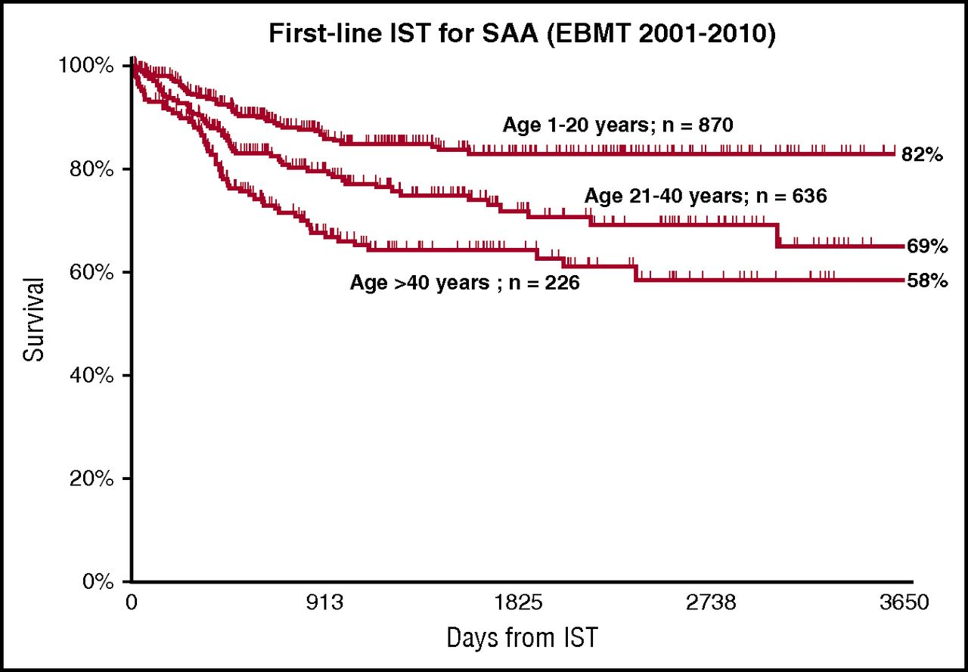
How I treat acquired aplastic anemia
Andrea Bacigalupo, How I treat acquired aplastic anemia, Blood, 2017,
Notes:
Figure Legend:
The age effect in patients receiving first-line IST. Data from the EBMT registry.

Slide 32
Eltrombopag Added to Immunosuppression in Severe Aplastic Anemia
R Peffault de Latour et al. N Engl J Med 2022;386:11-23.
Notes:
Download a PDF of the Research Summary.

Slide 33
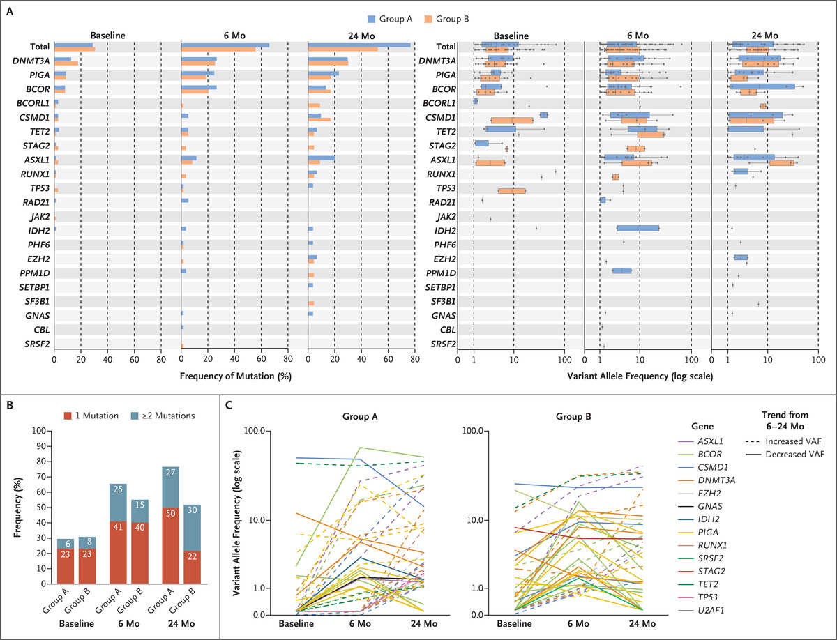
Somatic Mutations.
R Peffault de Latour et al. N Engl J Med 2022;386:11-23.
Notes:
Figure 2. Somatic Mutations. Panel A shows the frequency and variant allele frequency (VAF) of mutations at baseline, 6 months, and 24 months. The variant allele frequency of the mutations is shown on a logarithmic scale. The box-and-whisker plots of the specific gene mutations are shown; the whiskers indicate the range, the sides of the boxes indicate the interquartile range, and the vertical line within each box indicates the median. The gray dots indicate individual mutations, and the vertical lines over some of the gray dots indicate the range (minimum and maximum). Panel B shows the frequency of mutations as a measure of 1 or 2 or more mutations in each group at different time points. Panel C shows the variant allele frequency of mutations in each group in patients who were screened (45 patients) and had detectable mutations (34 patients) at all three time points.

Slide 34
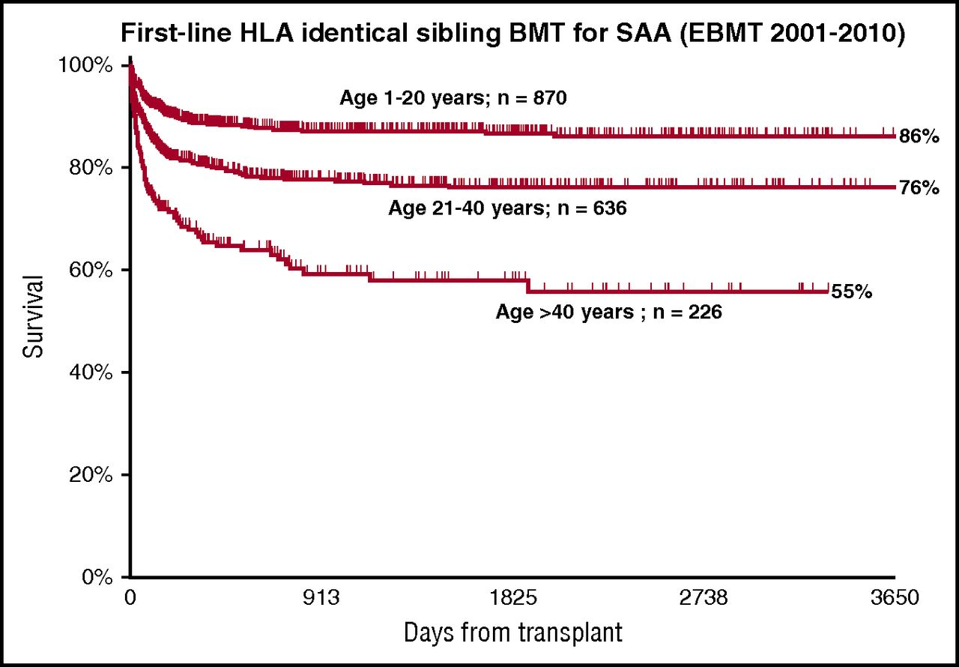
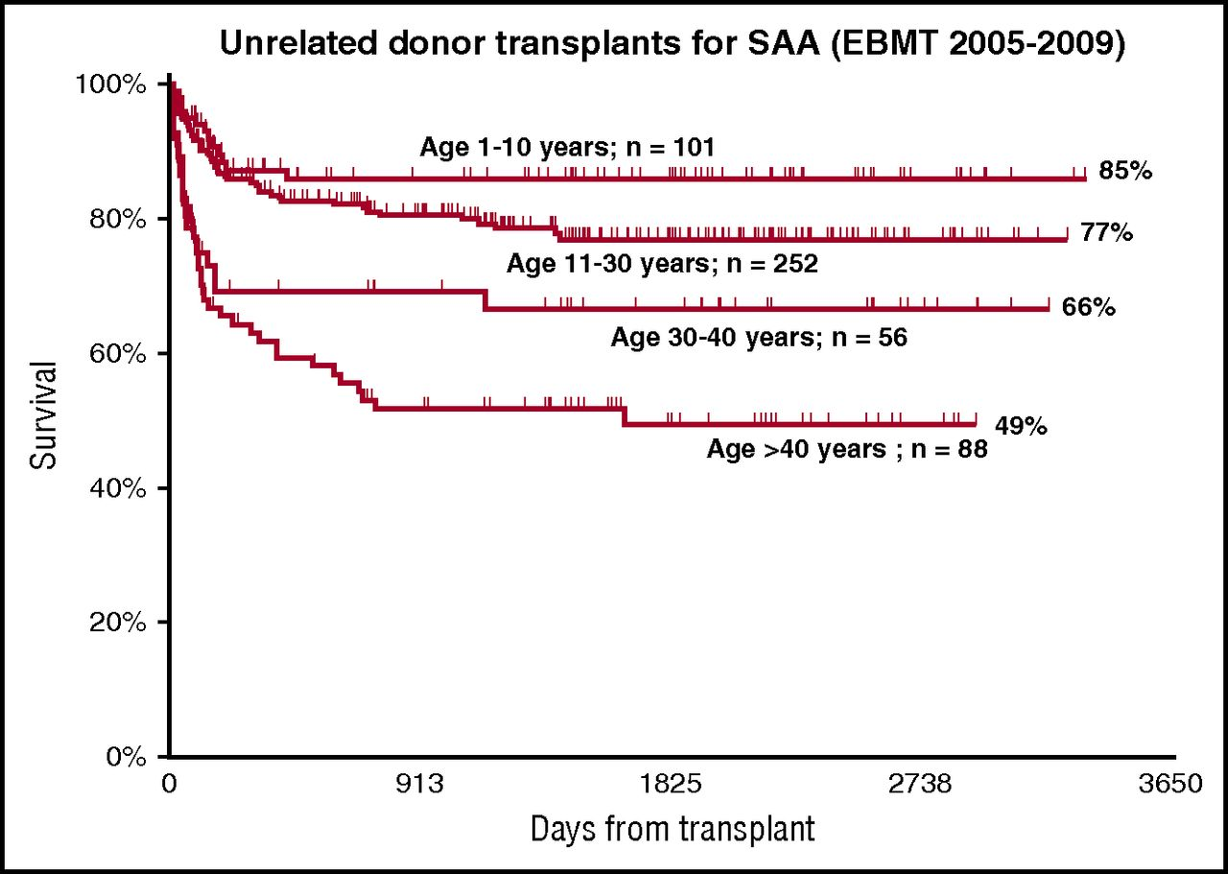
First line Sibling HSCT and MUD HSCT
Andrea Bacigalupo, How I treat acquired aplastic anemia, Blood, 2017,
Notes:
Figure Legend:
A strong age effect in patients with aplastic anemia, after transplantation from an HLA identical sibling. Data from the EBMT registry.

Slide 35
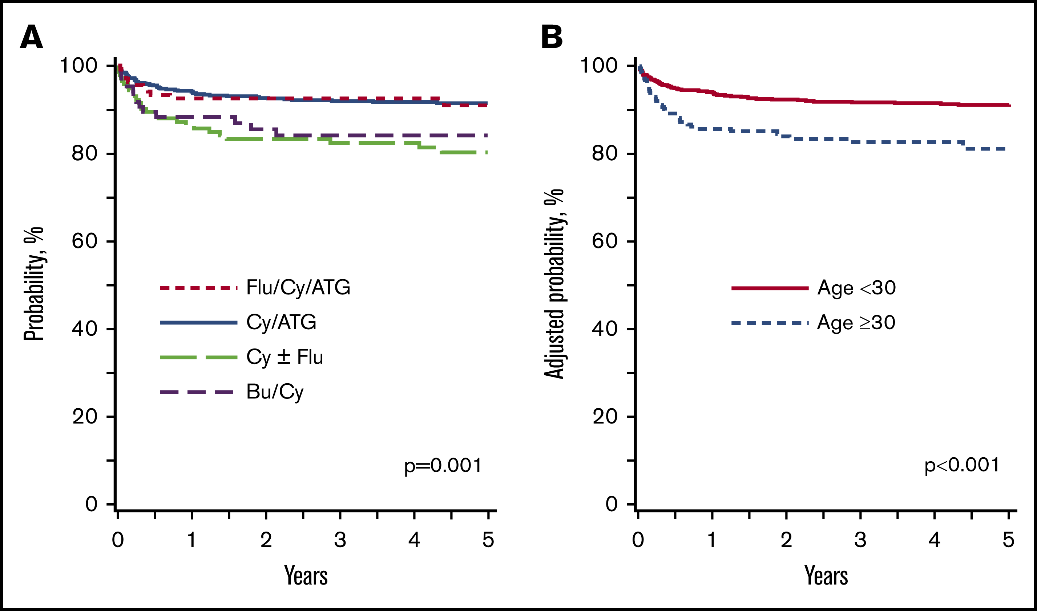
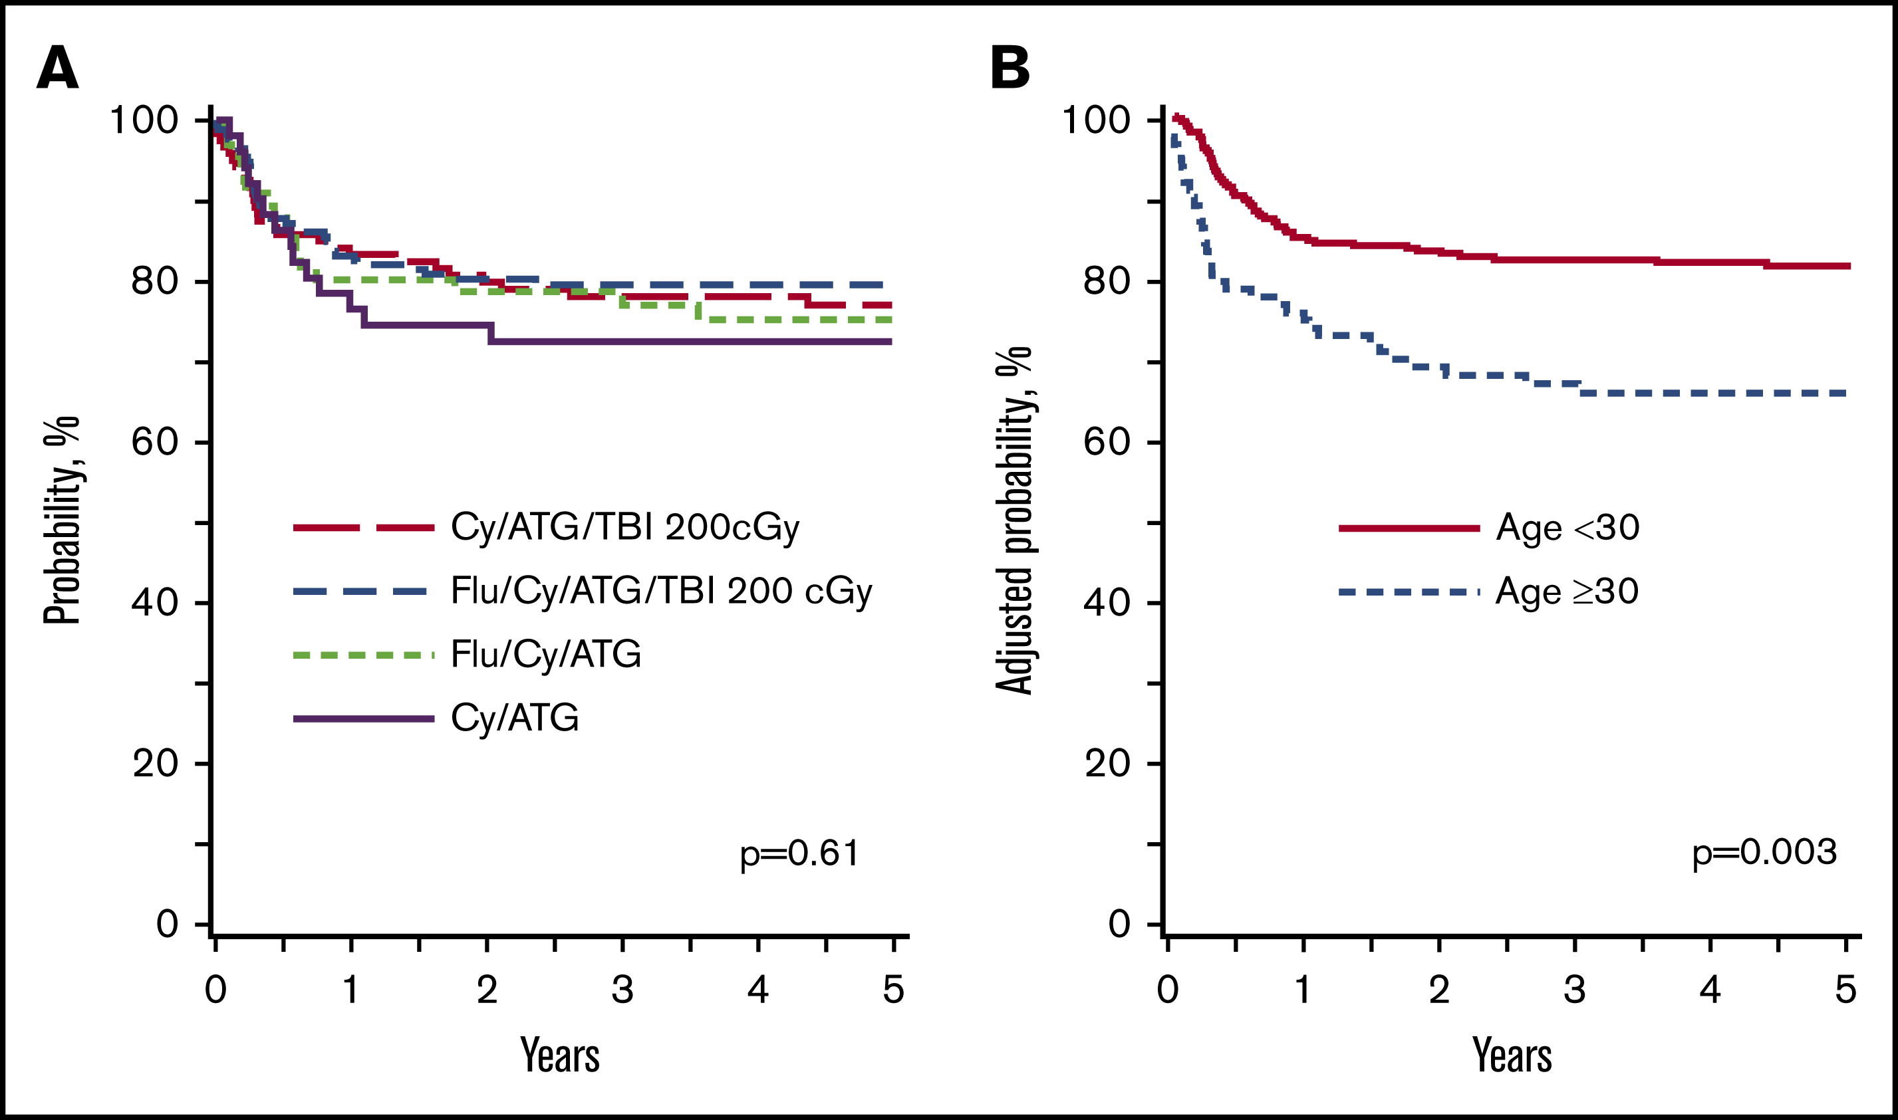
Choice of conditioning regimens for bone marrow transplantation in severe aplastic anemia
MATCHED SIBLING DONOR
MATCHED UNRELATED DONOR
Nelli Bejanyan etal. Blood Adv, 2019,
Notes:
Figure Legend:

Slide 36
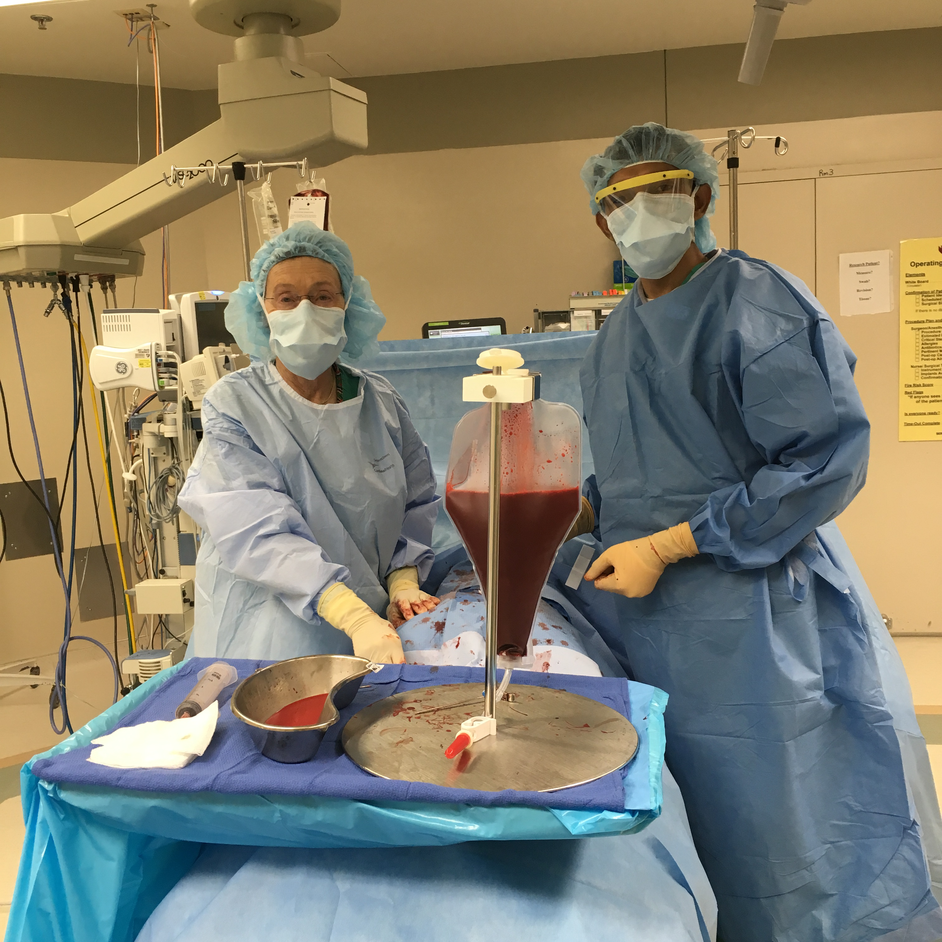
RBC content and stem cell source
HARVEST
Vs
Mobilized stem cells
Oshu.edu

Slide 37
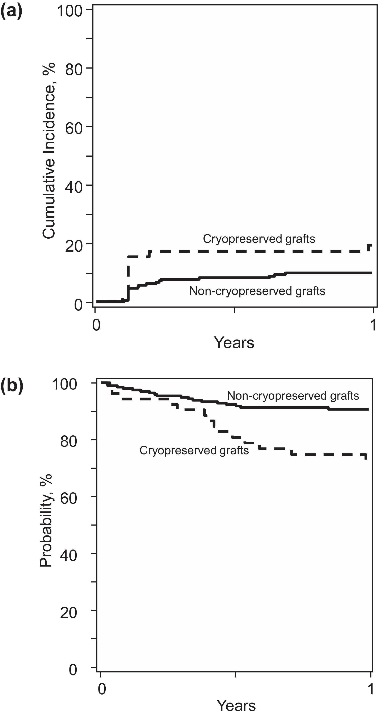
Hematopoietic Cell Transplantation with Cryopreserved Grafts for Severe Aplastic Anemia
CIBMTR data: 2013-2019
GRAFT FAILURE
OS: 73% Vs 91%
M Eapen etal. Biology of Blood and Marrow Transplantation 2020
Notes:
Graft failure and overall survival. (A) The 1-year graft failure was 19% (95% CI, 10% to 31%) in the cryopreserved group and 10% (95% CI, 6% to 14%) in the noncryopreserved group. (B) The 1-year overall survival was 73% (95% CI, 60% to 84%) in the cryopreserved group and 91% (95% CI, 86% to 94%) in the noncryopreserved group.

Slide 38
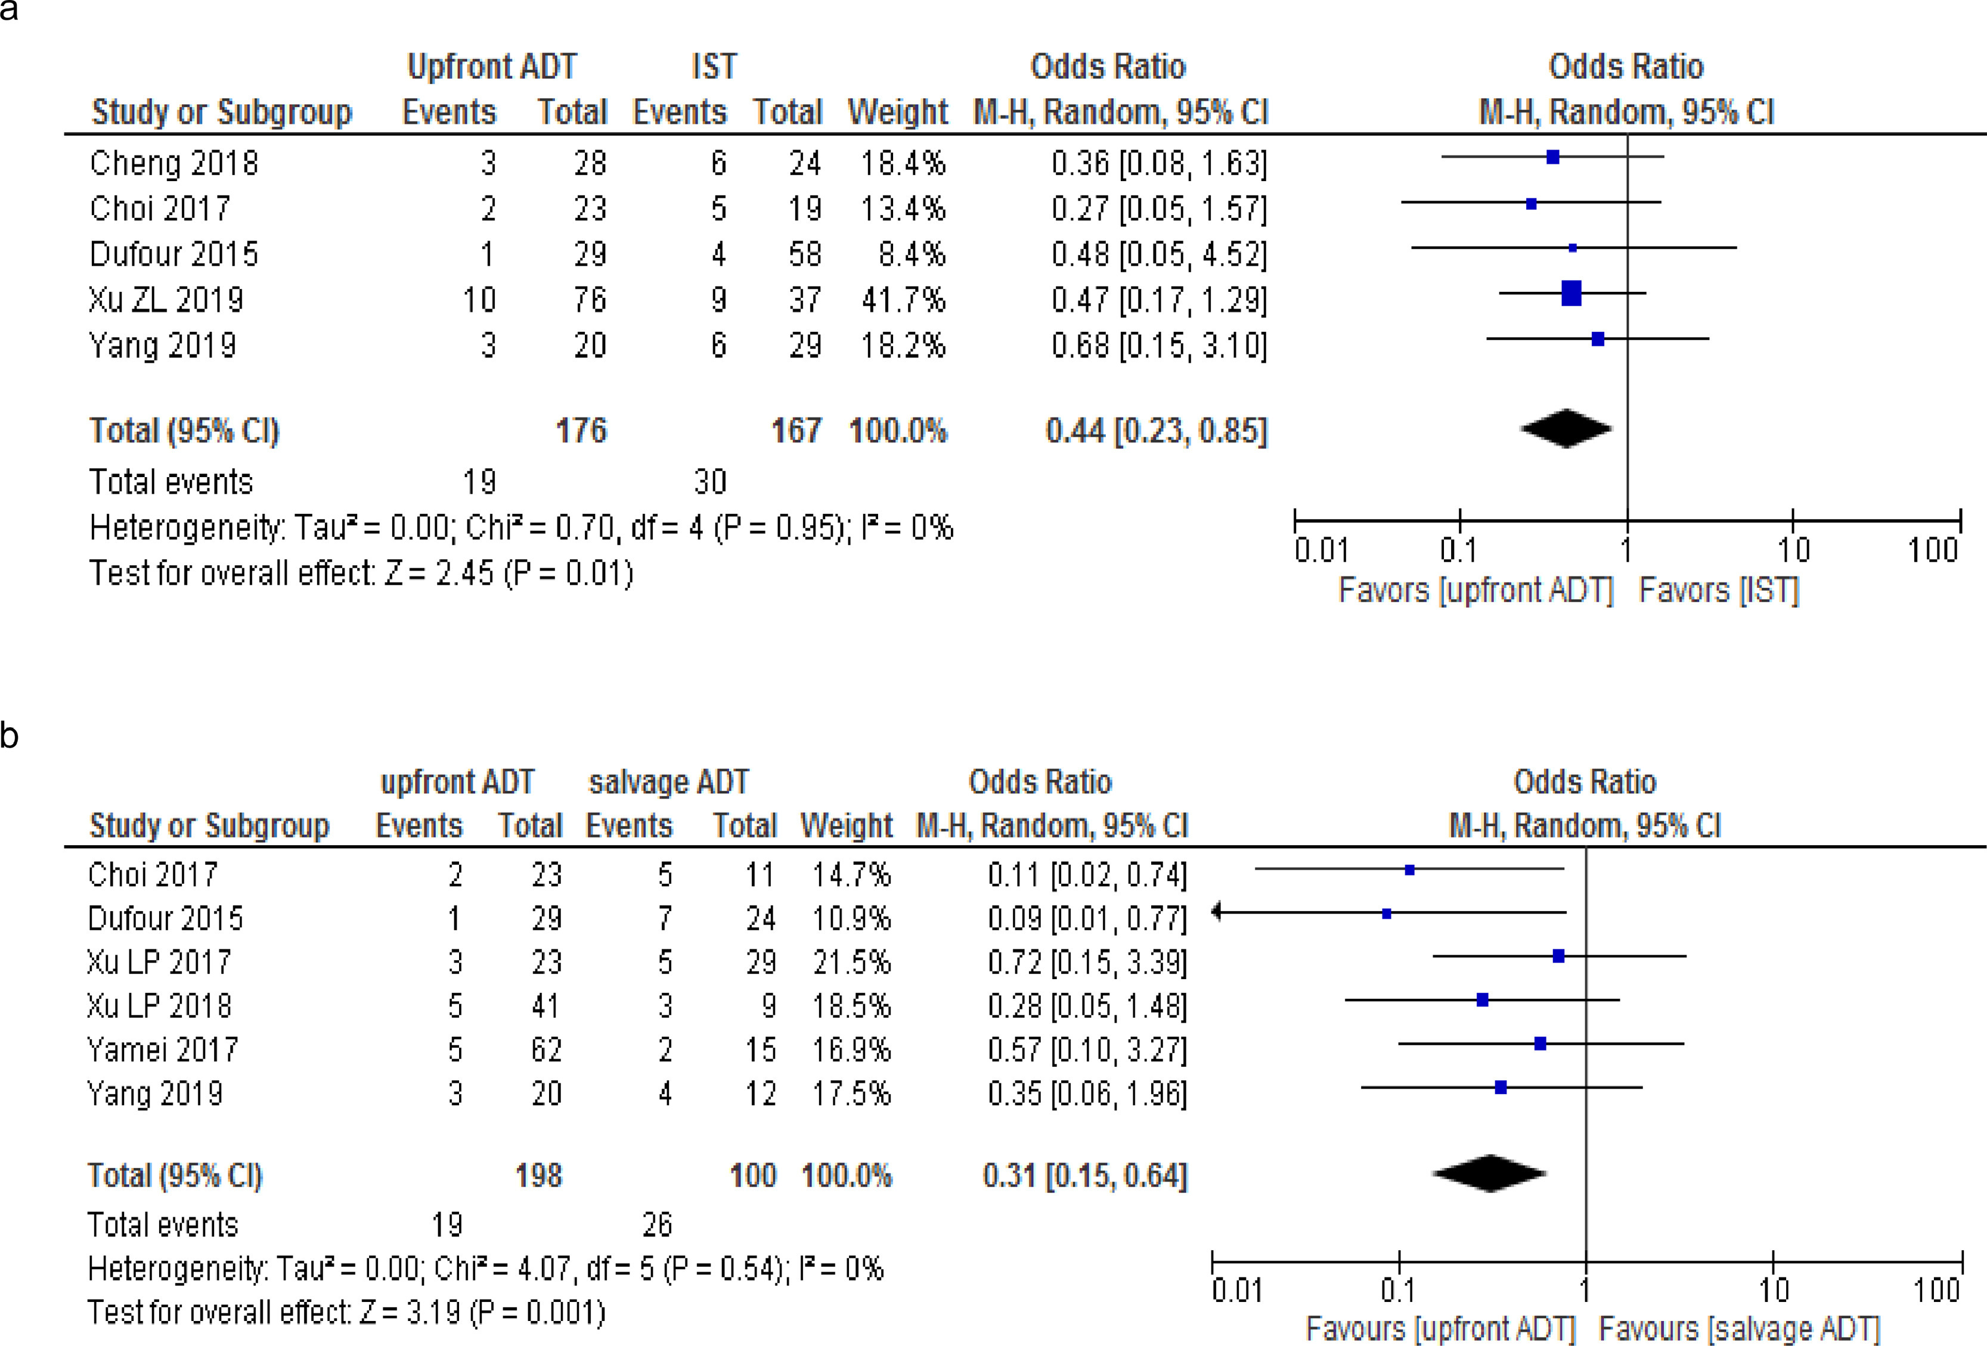
Upfront Alternative Donor Transplant versus Immunosuppressive Therapy in Patients with Severe Aplastic Anemia Who Lack a Fully HLA-Matched Related Donor: Systematic Review and Meta-Analysis of Retrospective Studies, on Behalf of the Severe Aplastic Anemia Working Party of the European Group for Blood and Marrow Transplantation
Upfront ADT versus IST comparison (A) and upfront ADT versus salvage ADT comparison (B).
H. Alotaibi et al. / Transplantation and Cellular Therapy 28 (2022) 105.

Slide 39
BMT CTN PLANNING FOR AN Upfront alternative donor HCT
(MUD and Haplo donors)
for adults (21 y and above) with severe aplastic anemia using
PT Cy based GVHD prophylaxis

Slide 40
Conclusions
Patients affected with MDS should be tested for any identifiable mutations to better risk stratify.
Patients affected with aplastic anemia should be tested for existing PNH clones (Acquired AA)
Bone marrow transplant should be considered in patients with MDS (intermediate 2 or higher by IPSS) when transplant eligible and suitable donor available.
Bone marrow transplant should be considered upfront for SAA when matched sibling donor is available for patients <40 y and for Matched unrelated donor for patients <20-30 y.

Slide 41
Thank you

